Slide 1


INTERGRATED CHRONIC CARE CLINIC: Neno Malawi
Dr. Victor Mithi
22 April 2022

Slide 2
BIO
MSc Public Health for Development Student
Former Chronic Care programs Manager
Partners in Health, Malawi Site
Worked on Integrated Chronic care CLinics

Slide 3
outline
Introduction to Pen-plus sites with the 5S model
Pen-plus training
District demographics
Integrating chronic care clinics

Slide 4
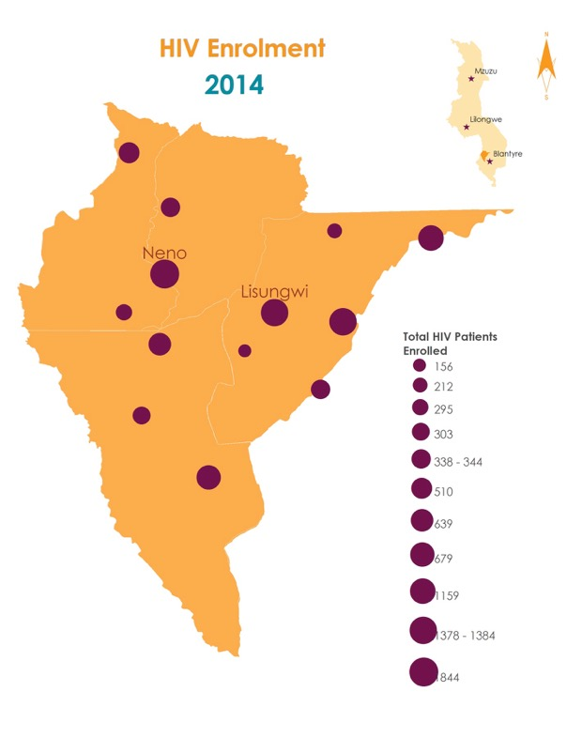


By end of 2014 Neno had 6,779 HIV patients active in care across 13 health centres…
Notes:
HIV was strong and at all the facilities in 2014

Slide 5
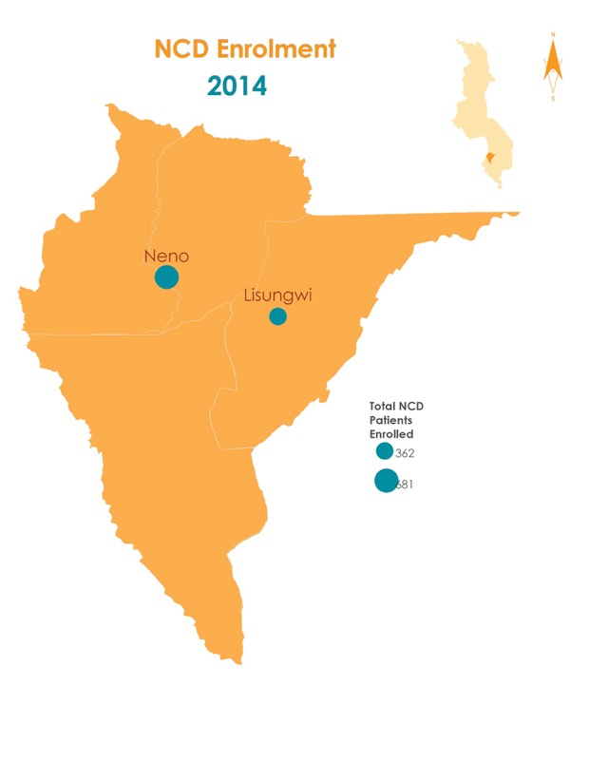
… but non-communicable disease care was limited to two hospitals, with only 884 patients in care
Notes:
We wanted to figure out a way to rapidly increase NCD access to care. We knew we had to decentralize to all clinics, but we also knew we didn’t have the resources to build vertical clinics. So we started the Integrated Chronic Care Clinic…

Slide 6
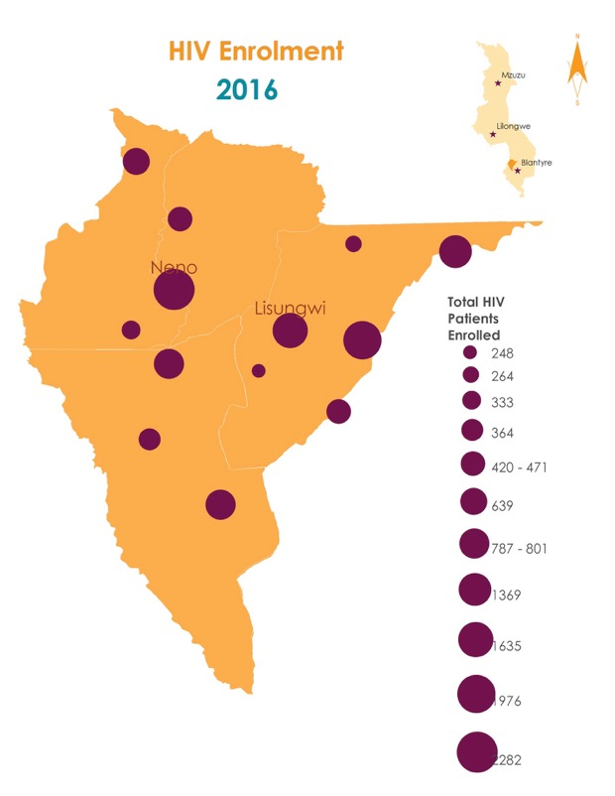
Integrated Chronic Care Clinic
NCD care scaled across 12 health centers & 2 hospitals with ~5,323 in care
Notes:
Additional analysis being done on outcomes but early results: 91% patients with chronic NCDs have visits in past 3 months

Slide 7





Implemented in 2015
HIV and NCD integration
    Patient-centric care model
    One appointment for all conditions


●
❍
■
Client Check-in and triage
Screening & direct referral
Education
Client sees clinician
Collect medicine and check out
E.B Wroe, et al., Leveraging HIV platforms to work toward comprehensive primary care in rural Malawi: the Integrated Chronic Care Clinic, Healthcare (2015), http://dx.doi.org/10.1016/j.hjdsi.2015.08.002i
Notes:
IC3 launched in 2015. To leverage HIV clinic success, maximize resources, and use existing staff/space/systems for efficiency.
More information:
Using the national Mastercards for HTN & DM (FYI WDF funded printing of some of those in the clinics they’ll be discussing tomorrow; we are using same ones with 1-2 very minor changes). We are also using the mastercard for epilepsy, piloting a Mastercard for mental health and CHF.
We use an EMR, based in OpenMRS, build off of our HIV program, that can generate reports, indicators, and lists of patients who miss visit so we can track them. It also generates a list of patients due in clinic each day and tells support staff who needs a lab draw (for viral load for HIV patients, or eg kidney function for a diabetes patient)
There’s a very standardized patient flow that provides screening for other conditions as patients check in (TB, HIV, hypertension, diabetes).
Staff: Clinician, nurse, clerks. Stuff: Same for PEN Plus, Space: Existing HIV clinic space, System: Leveraged existing HIV systems, Social Support: PIH POSER

Slide 8
Chronic Care ecosystem: Programs, Conditions, Staffing, & Funding
WHERE CAN WE GO?
Conditions
Providers
Referral Hospital
Specialist Clinics
Specialist Clinics
Specialist Clinics
Specialist Clinics
Severe chronic disease for surgical referral
Advanced imaging
Complications
Specialist physicians
Nurses with advanced training
Highly technical cadres (e.g., ultrasonographers)
Palliative Care
First Level Hospital
Severe chronic NCDs (PEN-Plus): T1D, RHD, SCD, etc.
Conditions requiring palliative care
Severe or unstable mental health conditions
Mid-level providers: clinical officers, nurses (sometimes GPs depending on context)
Ancillary providers (pharmacists, nutritionists, social workers)
Inpatient wards
Primary care clinics
Referral Hospitals
Outpatient clinics
PEN-Plus
Advanced Mental Health
Primary Care
Outpatient clinics
Inpatient wards
Community Health Workers
Community screening
HIV
TB
NCDs (PEN): DM2, HTN, asthma, epilepsy
Depression
Frontline healthcare workers: nurses, medical assistants, clerks
Integrated Chronic Care Clinics

Slide 9
Chronic Conditions Step wise care model
Palliative care
Pen plus conditions and advanced HIV
IC3
General population

Slide 10
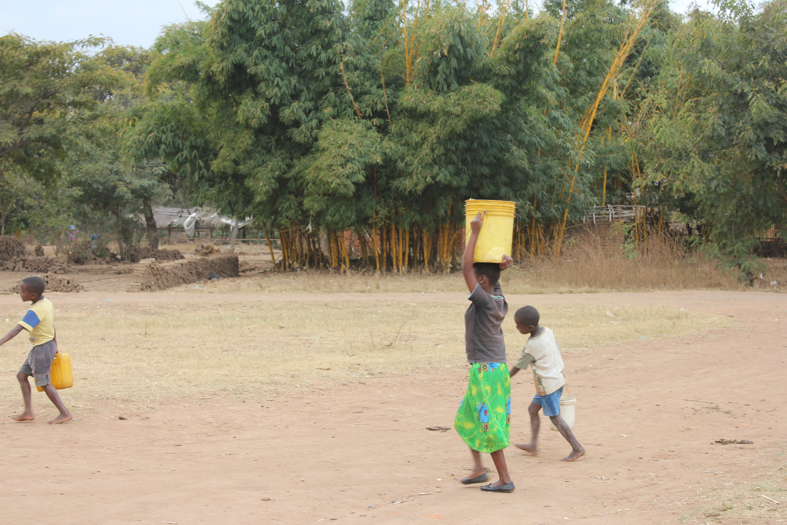
The End!
APZU Communication Orientation

