Slide 1
Working experience at the Argentinian Directorate of Epidemiology
from the statistics to communities-focus work

Slide 2
Principal areas
Some activities and products
Epidemiologic Surveillance
Data analysis and information production for infectious disease decition making
Outbreak Alert and Response
Surveillance bulletin
Epidemiological alerts
Monitoring of the surveillance system
outbreak detection and support
Situation room
Guidelines for notifiable diseases

Slide 3
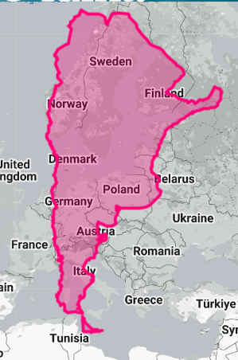
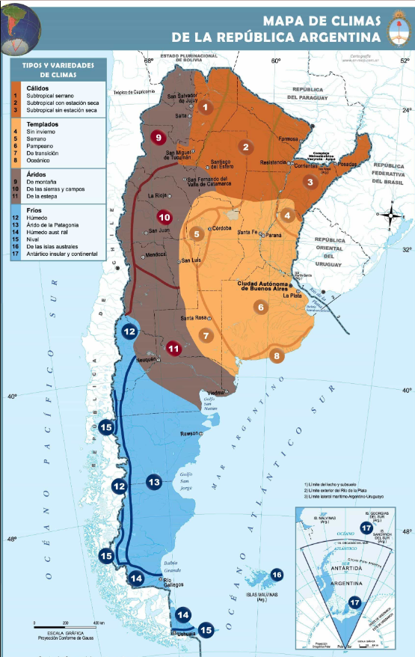
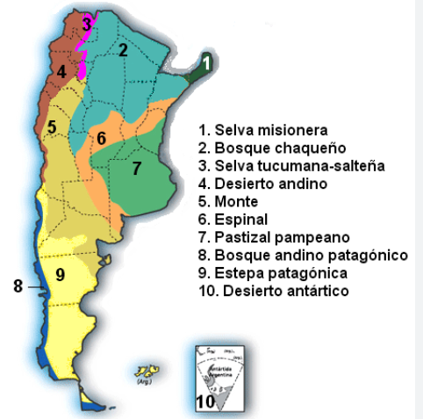
Argentina
Some notifiable events (I worked with)
>45 M habitants
24 provinces, >380 departments
31 indígenas communities
indigence (8.8%) and poverty (36.5%)
rural population <8%
Dengue
COVID
Rabies
Psitacosis
Yellow fever
Salmonella Paratyphi
Tuberculosis
Measles
Pneumonia

Slide 4
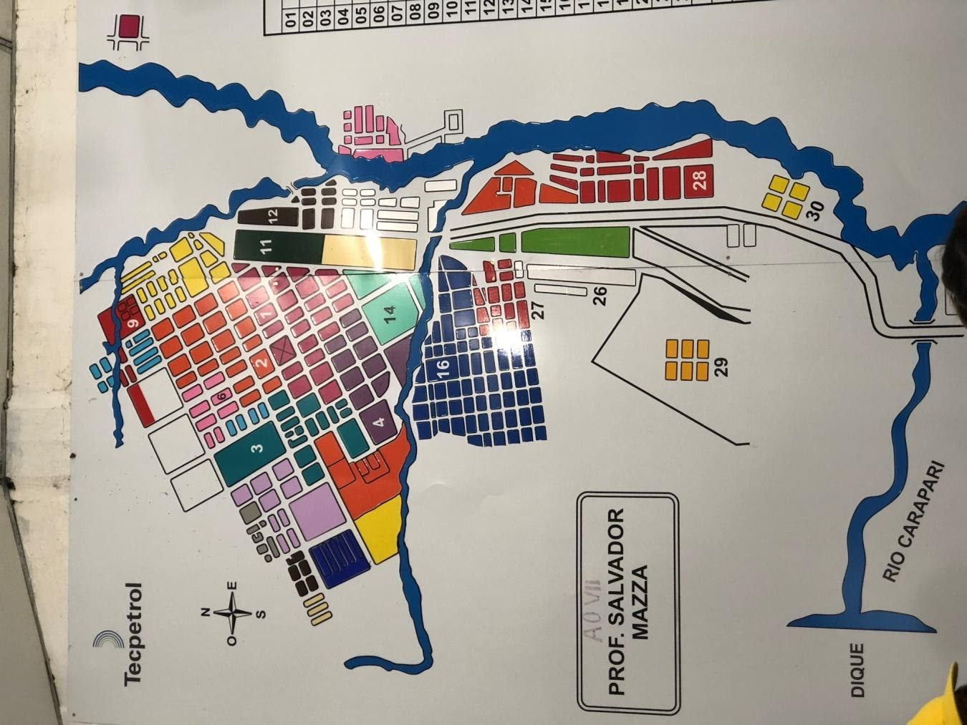
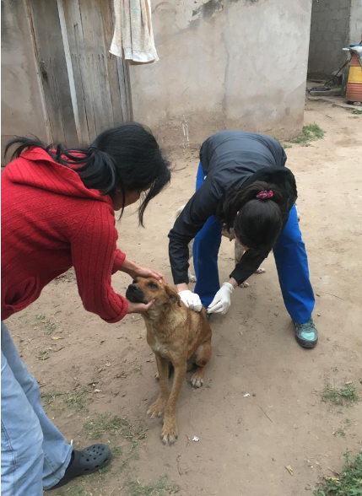
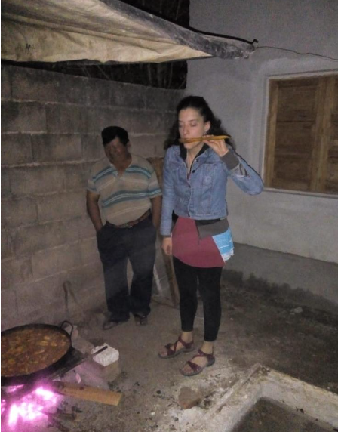
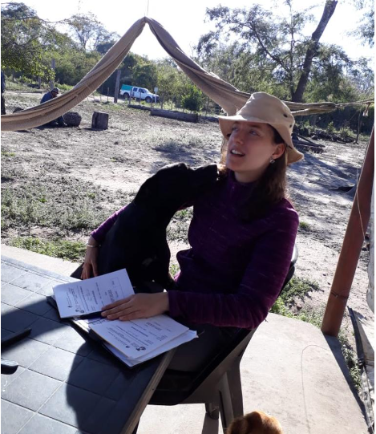
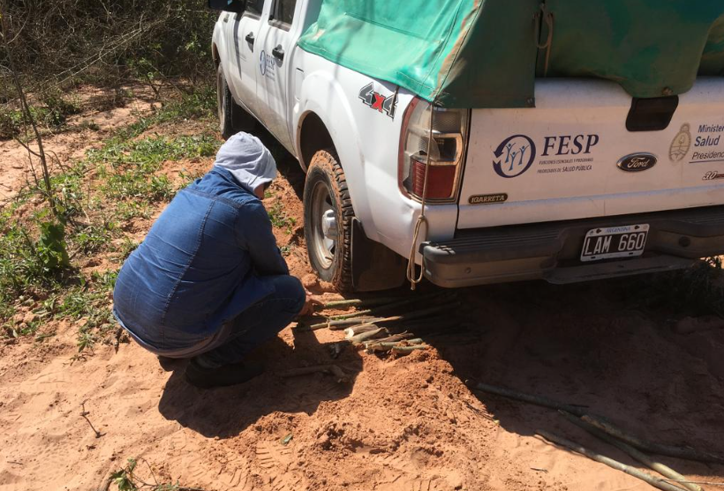
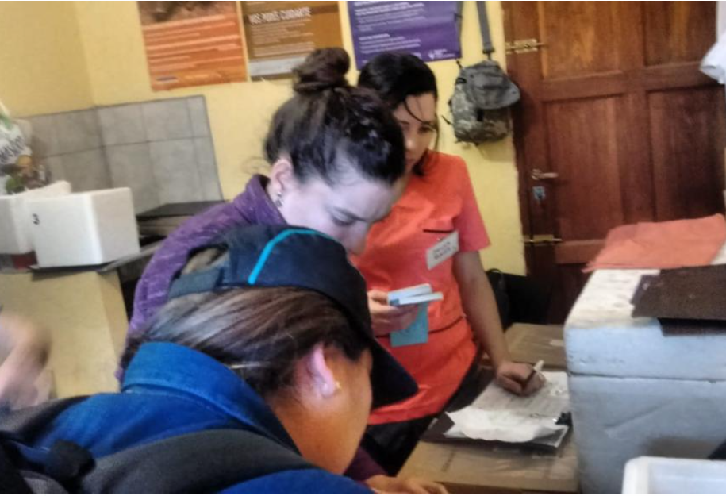
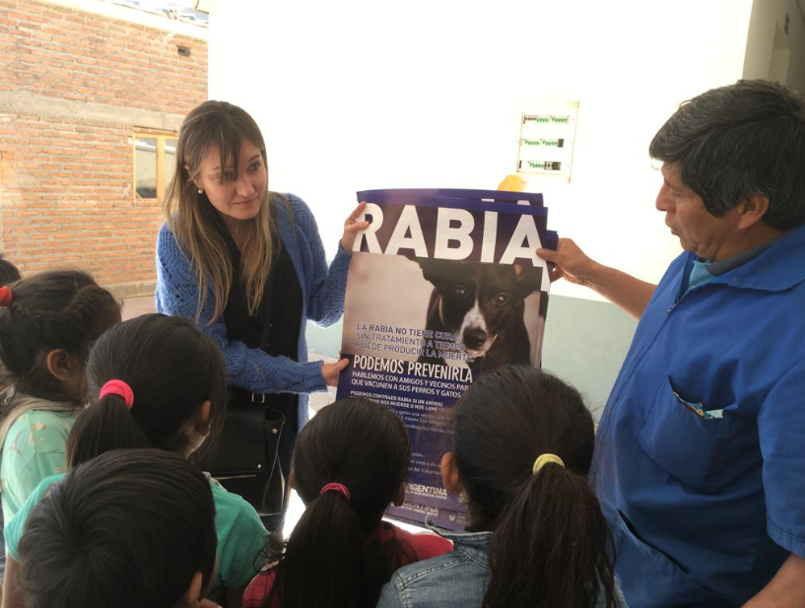
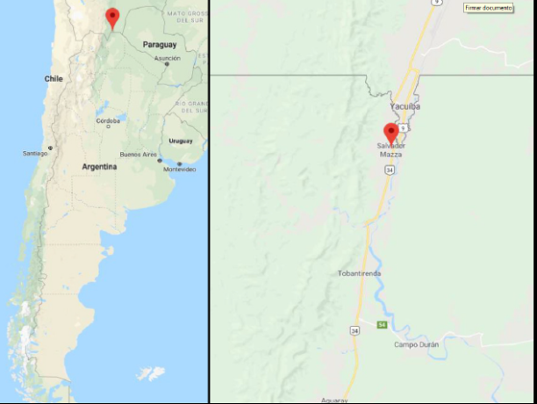
Rabies in Salvador Mazza: outbreak control
A case of canine rabies was detected and reported by the national surveillance system.
As a control strategy: vaccination of all dogs and cats.
Working with the local team (strengths)
Coverage achieved 79,5%
Notes:
Fortalezas equipo local (APS, conocimeinto del terreno, censo de mascotas) y nuestras (equipo interdisciplinario, con experiencia en terreno y trabajo con equipos locales)

Slide 5
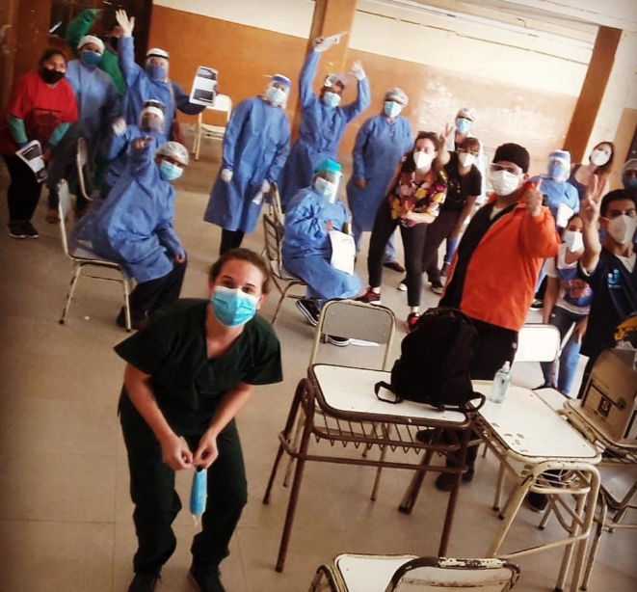
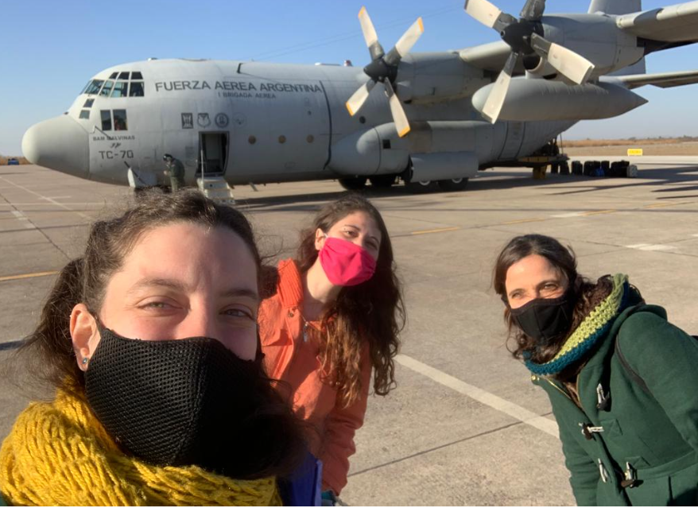
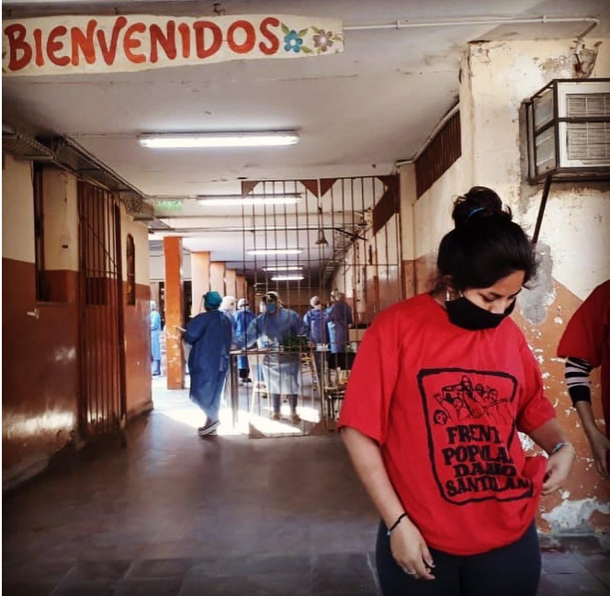
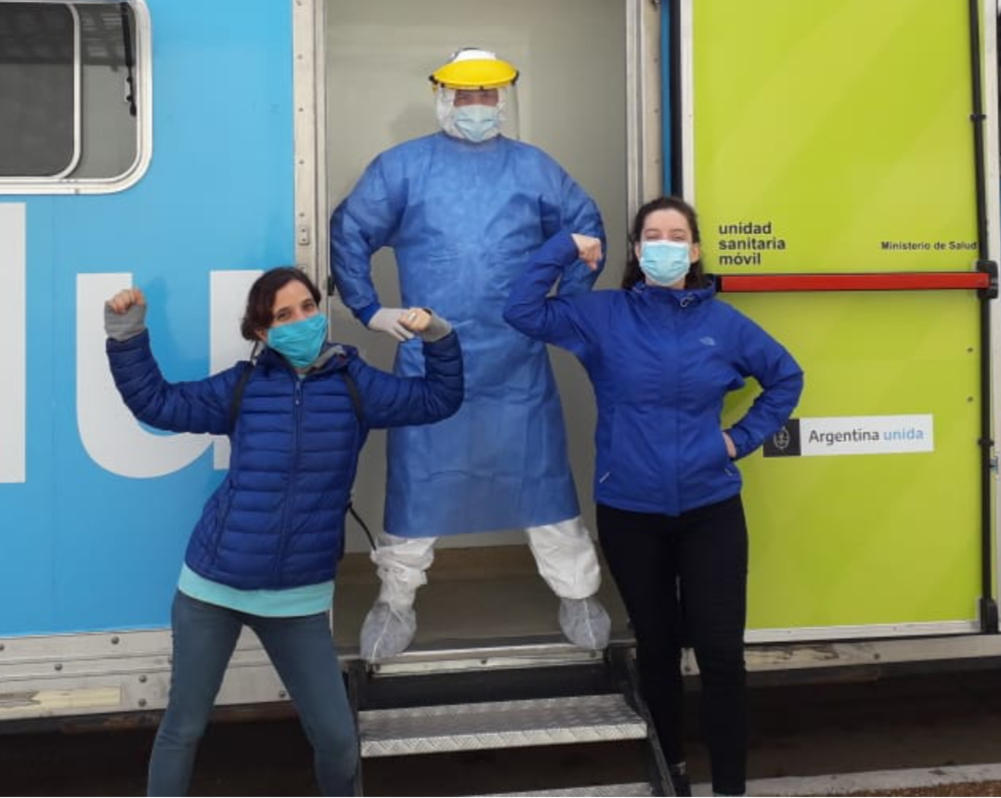
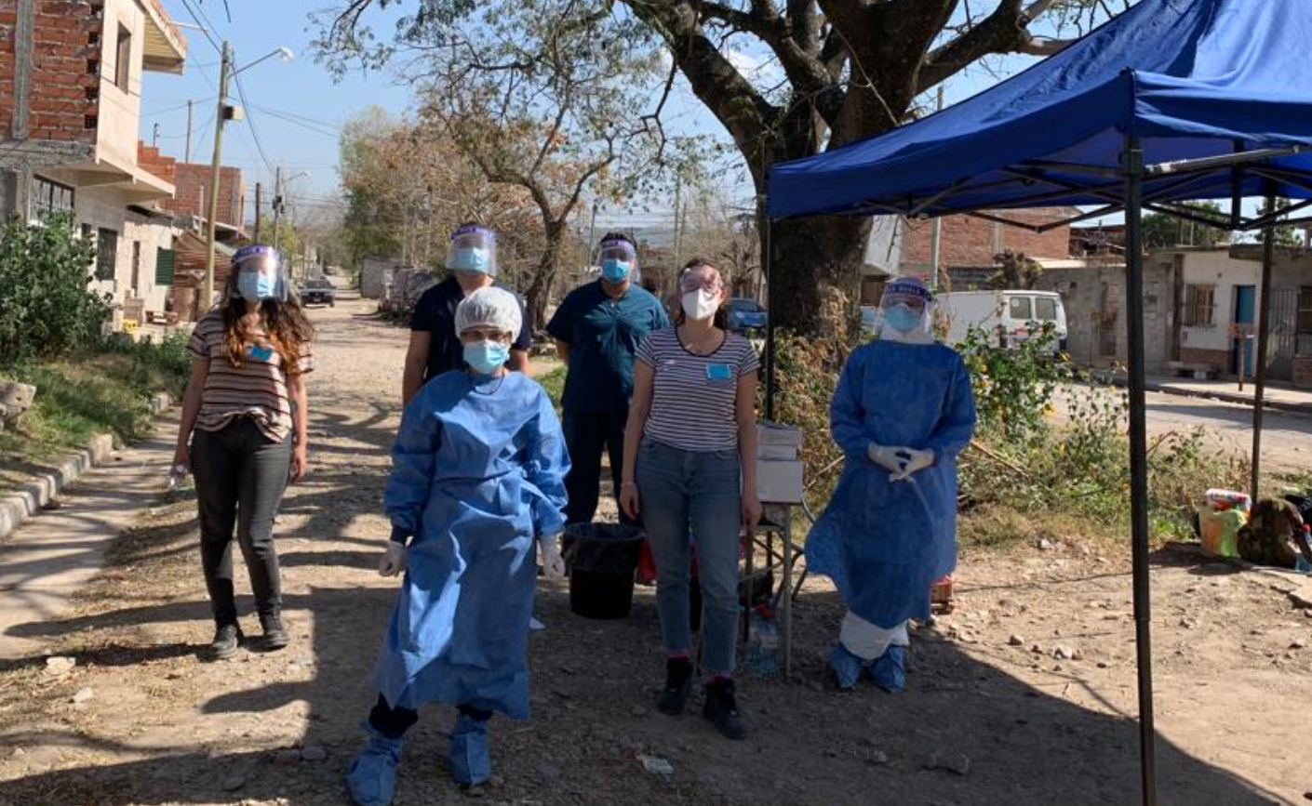
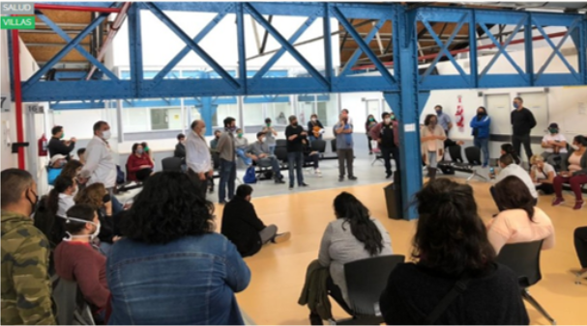
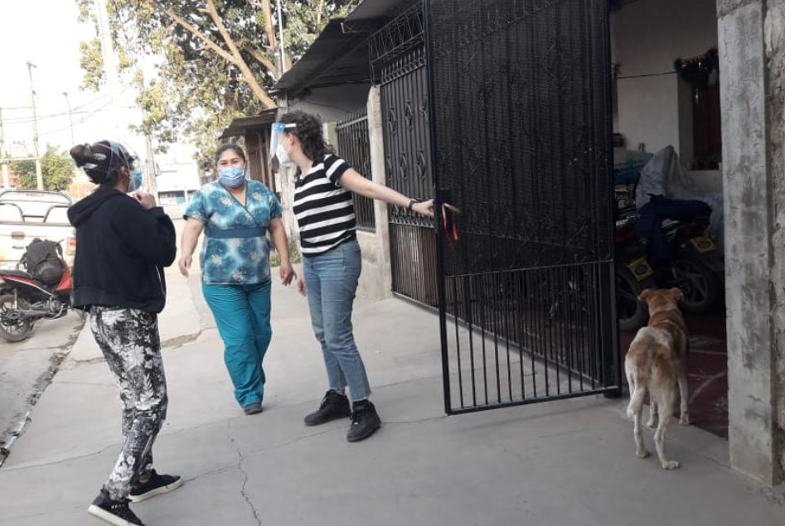
COVID-19: Surveillance and Control in Slums
People who lived in slums with inadequate housing and working conditions had limited agency to execute preventative measures and avoid exposure.
Focused outbreaks in slums
Proposal and creation of a team to monitor the outbreak in Slums
Strategies:
  More sensitive case definition
  Surveillance variable
  DETECTAR (active surveillance, local test access, isolation)

Slide 6
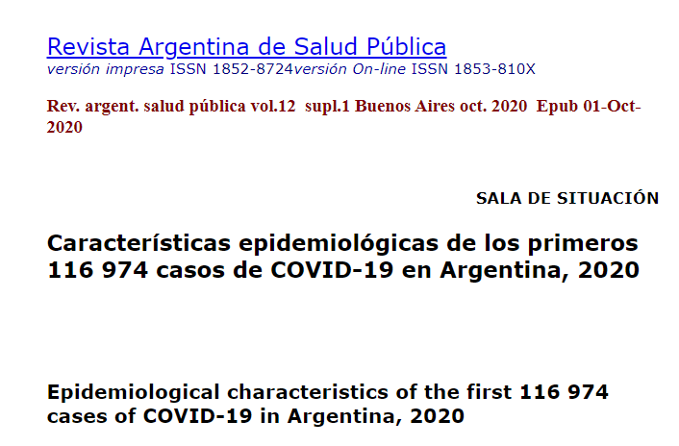
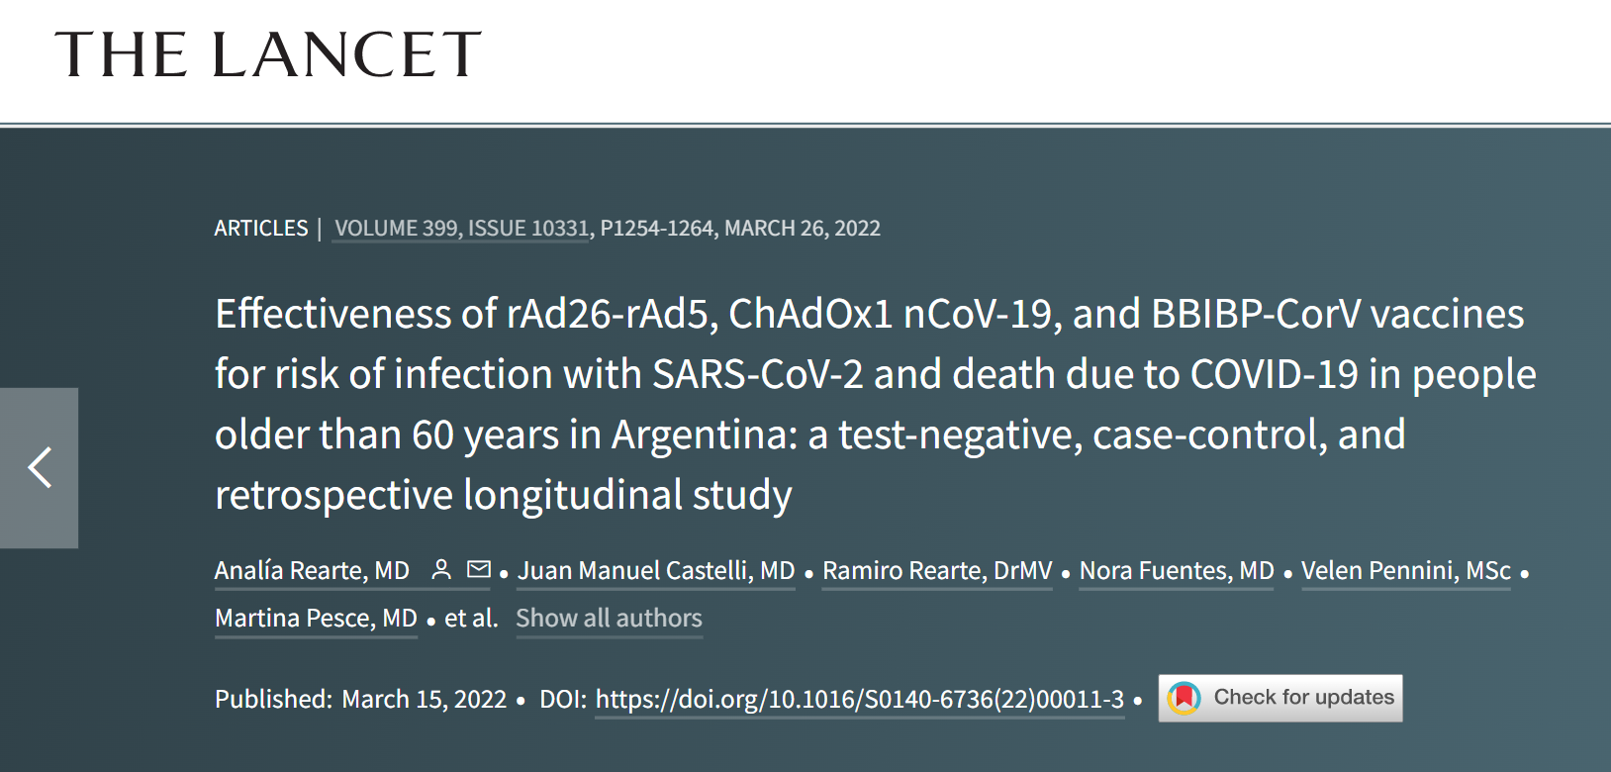
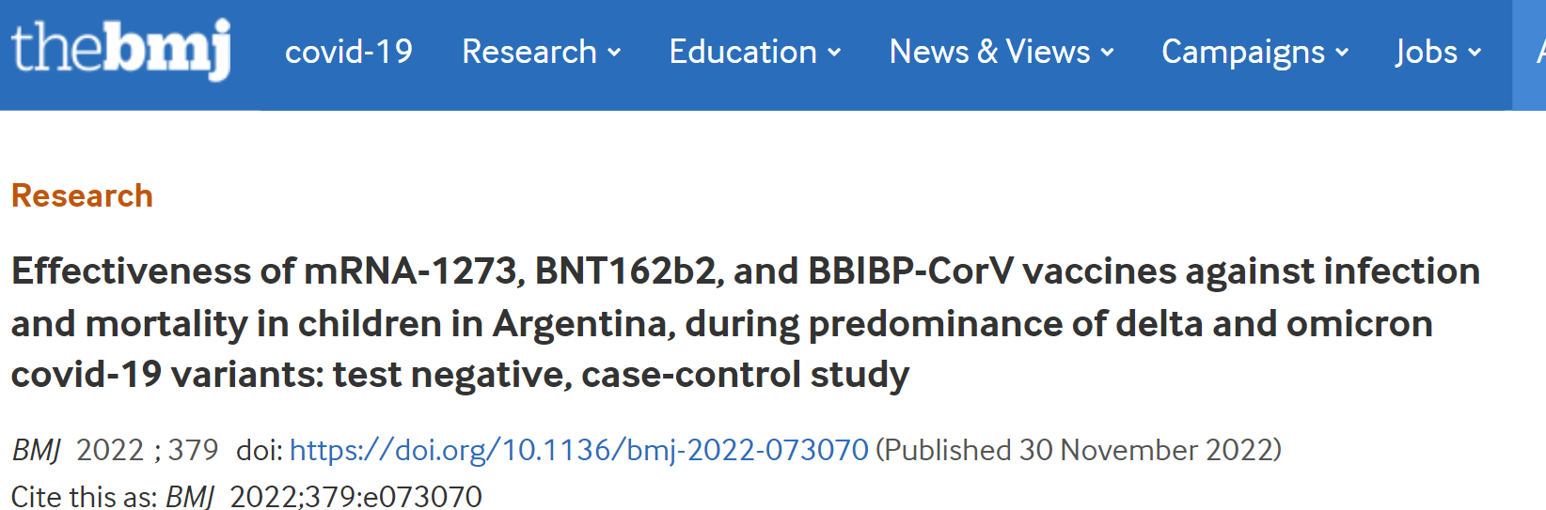
National production of scientific evidence as a tool for health sovereignty: COVID-19

Slide 7
LSHTM
Systematize and formalize my knowledge in methodology
Role of power in health policy
Peers experience
Global Health approach
Intercultural approach

Slide 8

GRACIAS! THANK YOU!

