Slide 1
The World of Sex ed
Hajer’s experience of

Slide 2


Sexual health
S
1. Clinical
2. Educational (RSE/PSHE) :
Drugs and alcohol
Healthy relationships
Online safety
FGM/Forced marriage
3. Mixture of both

Slide 3
Community youth programs
Leadership programs
Volunteering
Undergrade Modules
ICS- Restless development
Brook
ComeCorrect
Personal projects/workshops
Split Banana
Everyone is Invited
Ad’iyah Collective

Slide 4








Slide 5
Current projects / work

Slide 6


“Everyone’s Invited’s mission is to expose and eradicate rape culture with empathy, compassion, and understanding.”
Organisation was created to provide a safe place for survivors to share their stories completely anonymously.
Now they have developed a unique education programme for schools.
“Split Banana helps young people to build healthy relationships with their minds, their bodies and each other.”
Split Banana does this by delivering Relationship, Sex and Health Education in three ways: by running creative RSHE workshops with young people, by training educators and by consulting with schools and community organisations on their RSHE provision.

Slide 7

“Ad’iyah - Muslim Abortion Collective
Providing love, dua and support for Muslim folk during their abortion journeys.”
Ad’iyah is a community-based group of people who have had abortions and support those who have had abortions. Guided through the support of a trained Doula.

Slide 8
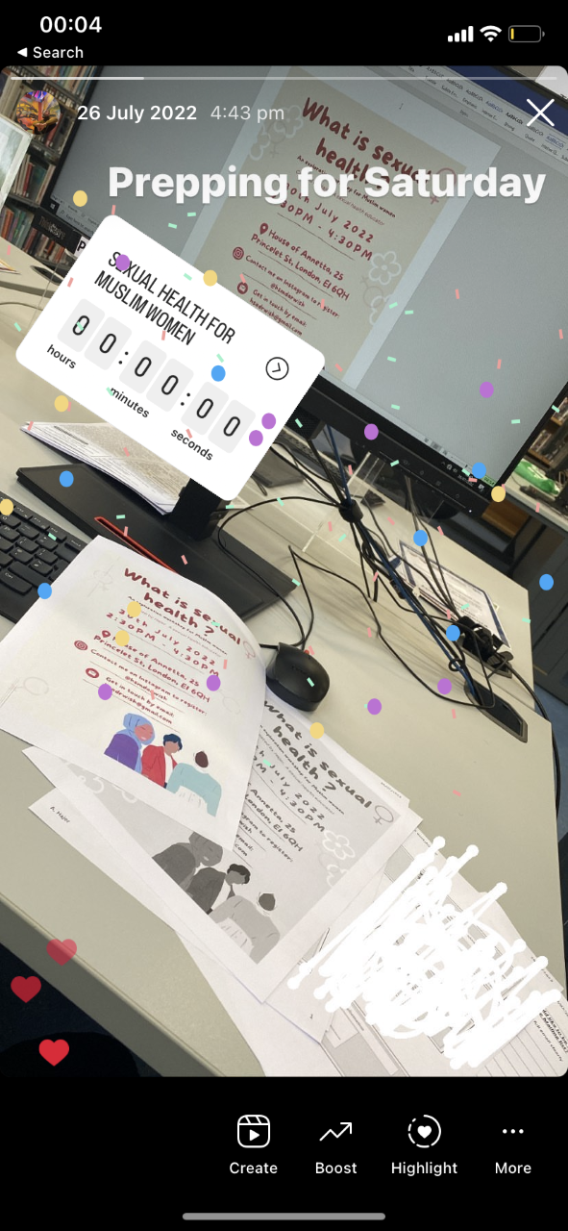
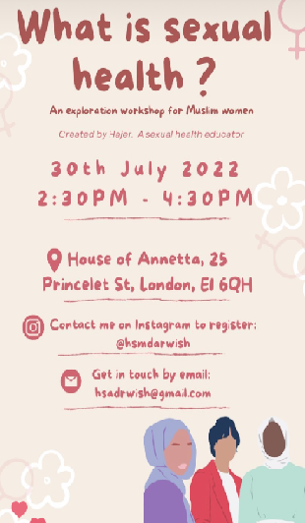
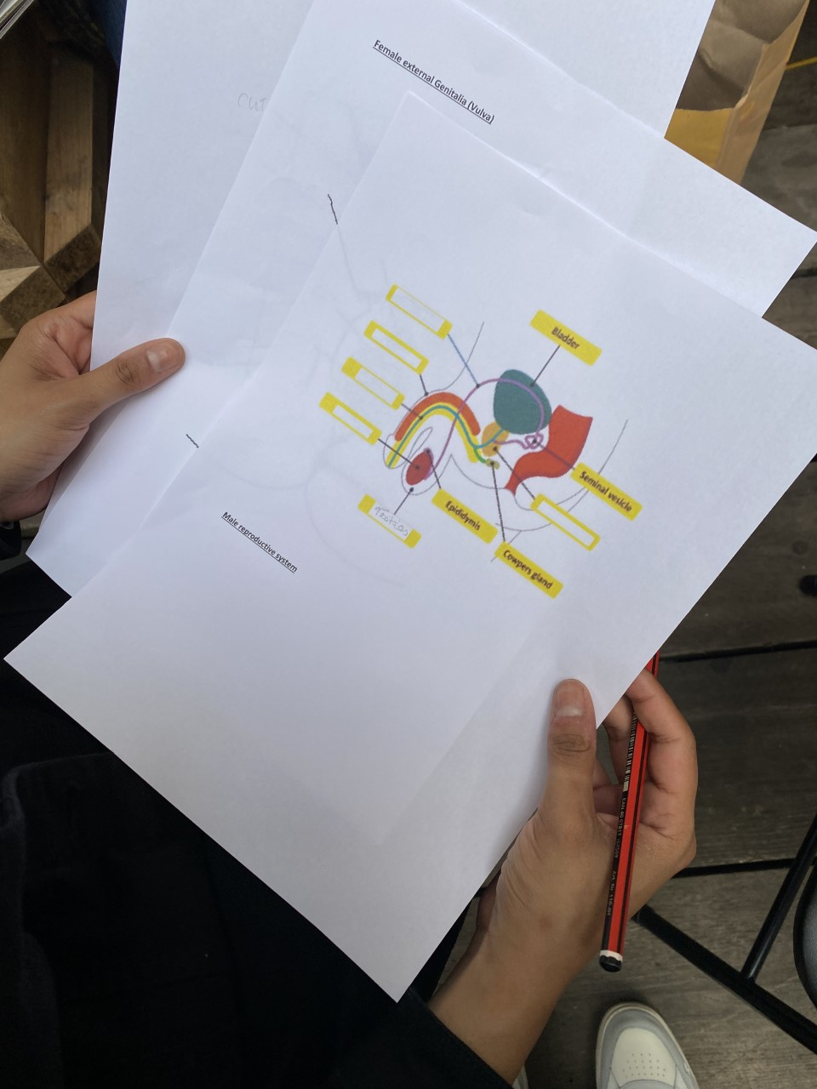
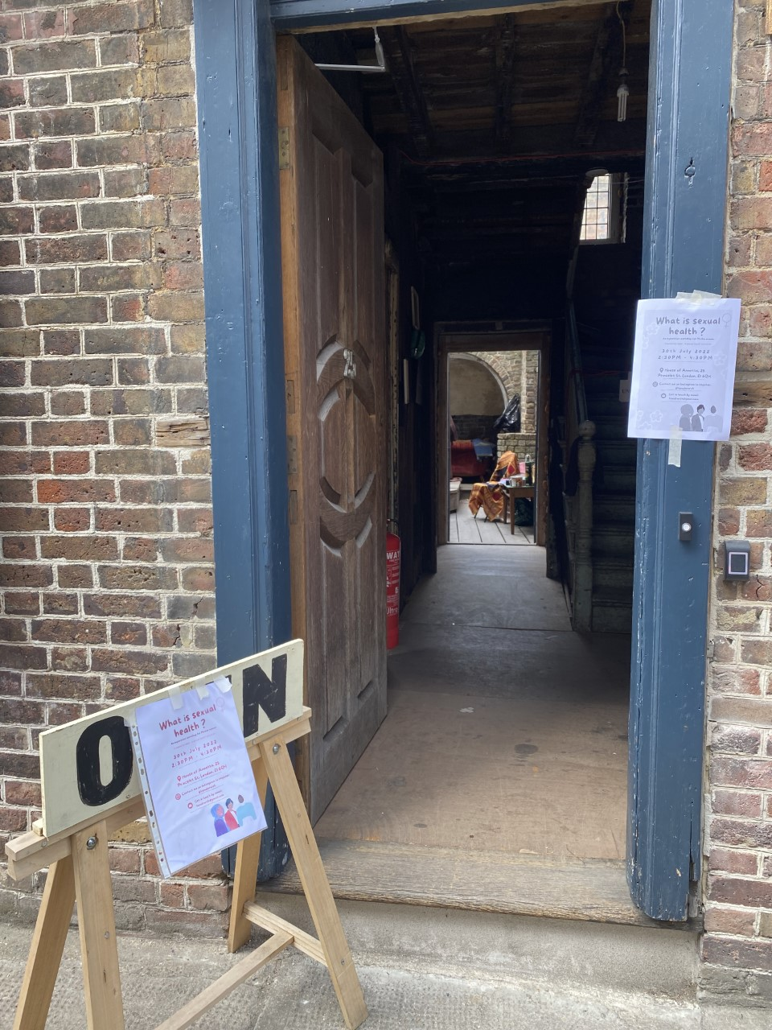
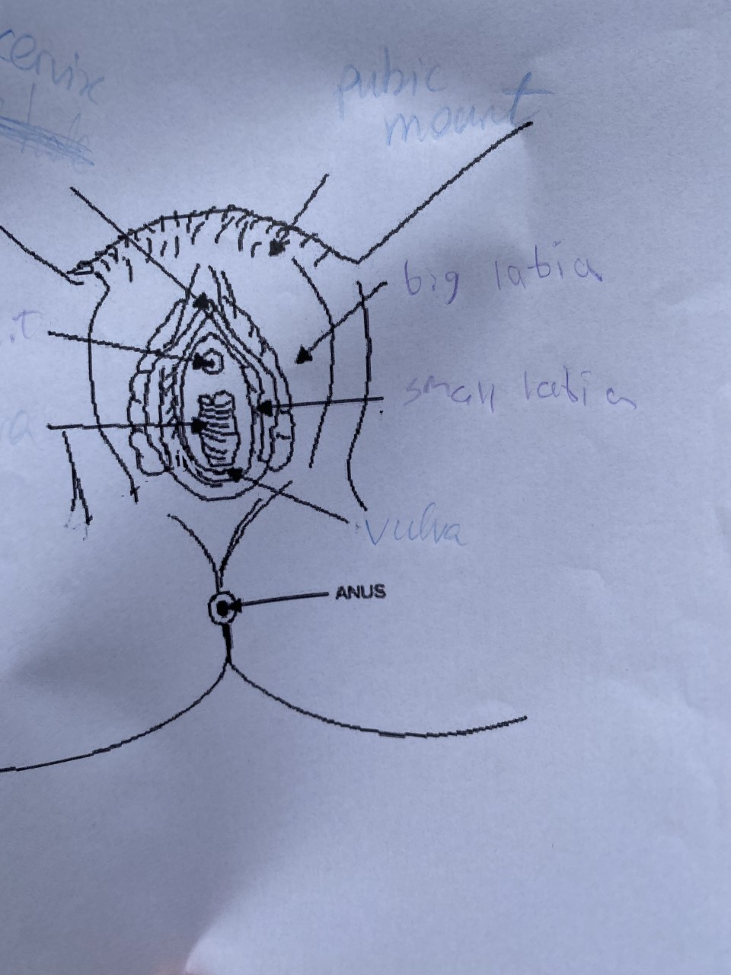
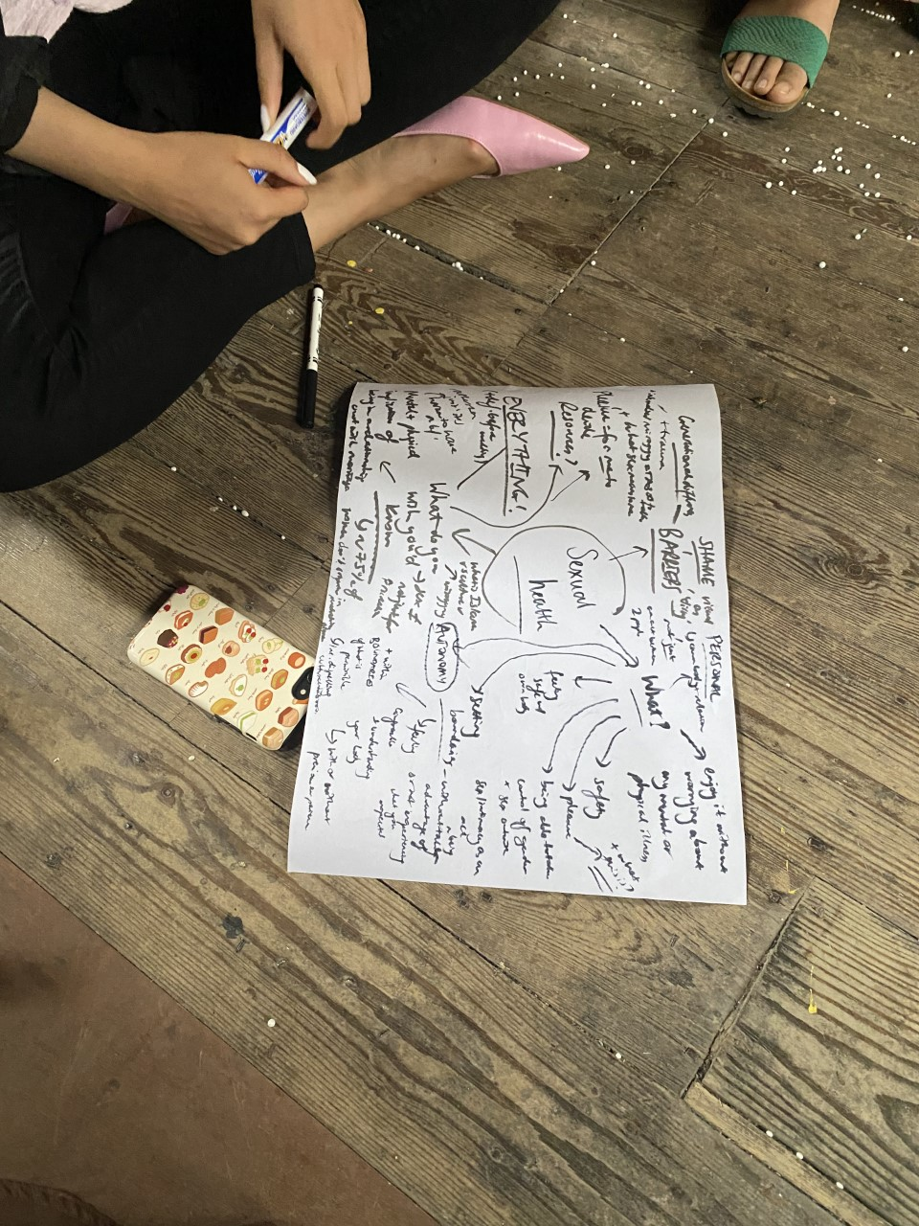
My Workshops

Slide 9

Next opportunity for you to take part in!
now
Free workshops Covering these topics –
Not only can you learn about these topics
You can also get a sense of the type of work you can get involved in !

Slide 10
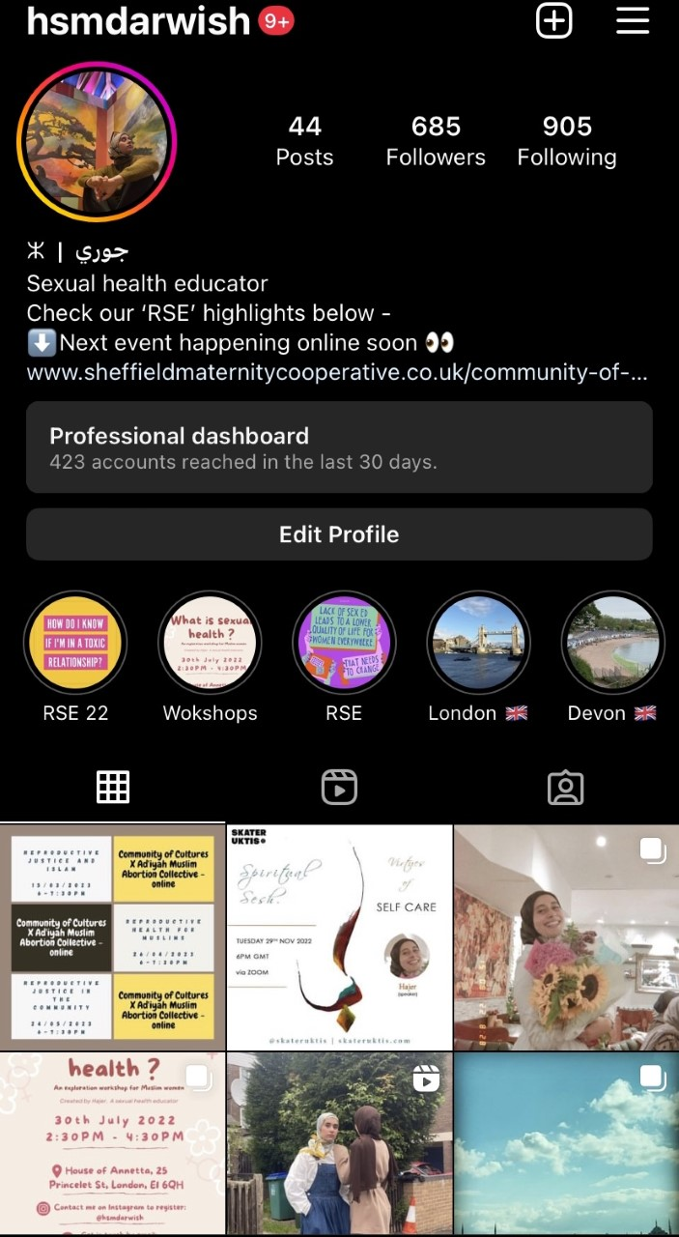
Where you can find me:
My imstagram handle @hsmdarwish
Links to events and workshops
Highlights of useful RSE related Info and events
Most recent post RSE related posts
Otherwise just my face and other people and things I love !

Slide 11
Why did I decide to go back to Academia ?

Slide 12

Thank you
@hsmdarwish

