Slide 1

Student Lead Seminar
Sexual Reproductive Health
Alhaji Mohamed Kamara
MSc. Reproductive and Sexual Health Research
Chevening Scholar

Slide 2
Outline
Overview of my organisation
Roles & Responsibilities
Why LSHTM
Next career step

Slide 3
Overview of my organisation
  MSI Reproductive Choices – Sierra Leone (locally known as “de mammy fo welbodi” or “the mother of health”, )
  Reputably known as the major actor in the SRH landscape in SL - provider of all modern methods of contraception (STM, LARC, Permanent) post-abortion care. Run a Social Business model approach.
  https://www.mariestopes.org.sl
  Run outpatient
  Laboratory services
  Maternal and child health services (ANC,PNC)
  Testing and treating for STIs,
  Cervical cancer screening and management (Pap smear & Cryotherapy)
  Channel of service delivery
  Mobile Outreach
  Static Clinics
  Social Marketing
  Public Sector Strengthening & Advocacy

Slide 4
Role & Responsibilities
  Deputy Director of Commercial (Clinics & Pharmacies operations) and Marketing – SL & Liberia
  My Work focused on four thematic areas:
  Proving overall leadership for the CMD
  Ensuring the Sustainability of the program
  Advocacy & public engagement
  Clinics operations (HR, supply chain)
  Major Projects
  DFID/FCDO grants, LAD, UNFPA
  SL2: Saving Lives phase II/Health System Strengthening
  WISH: Women Integrated Sexual Health
  SAFE: Safe Abortion for Every Woman

Slide 5
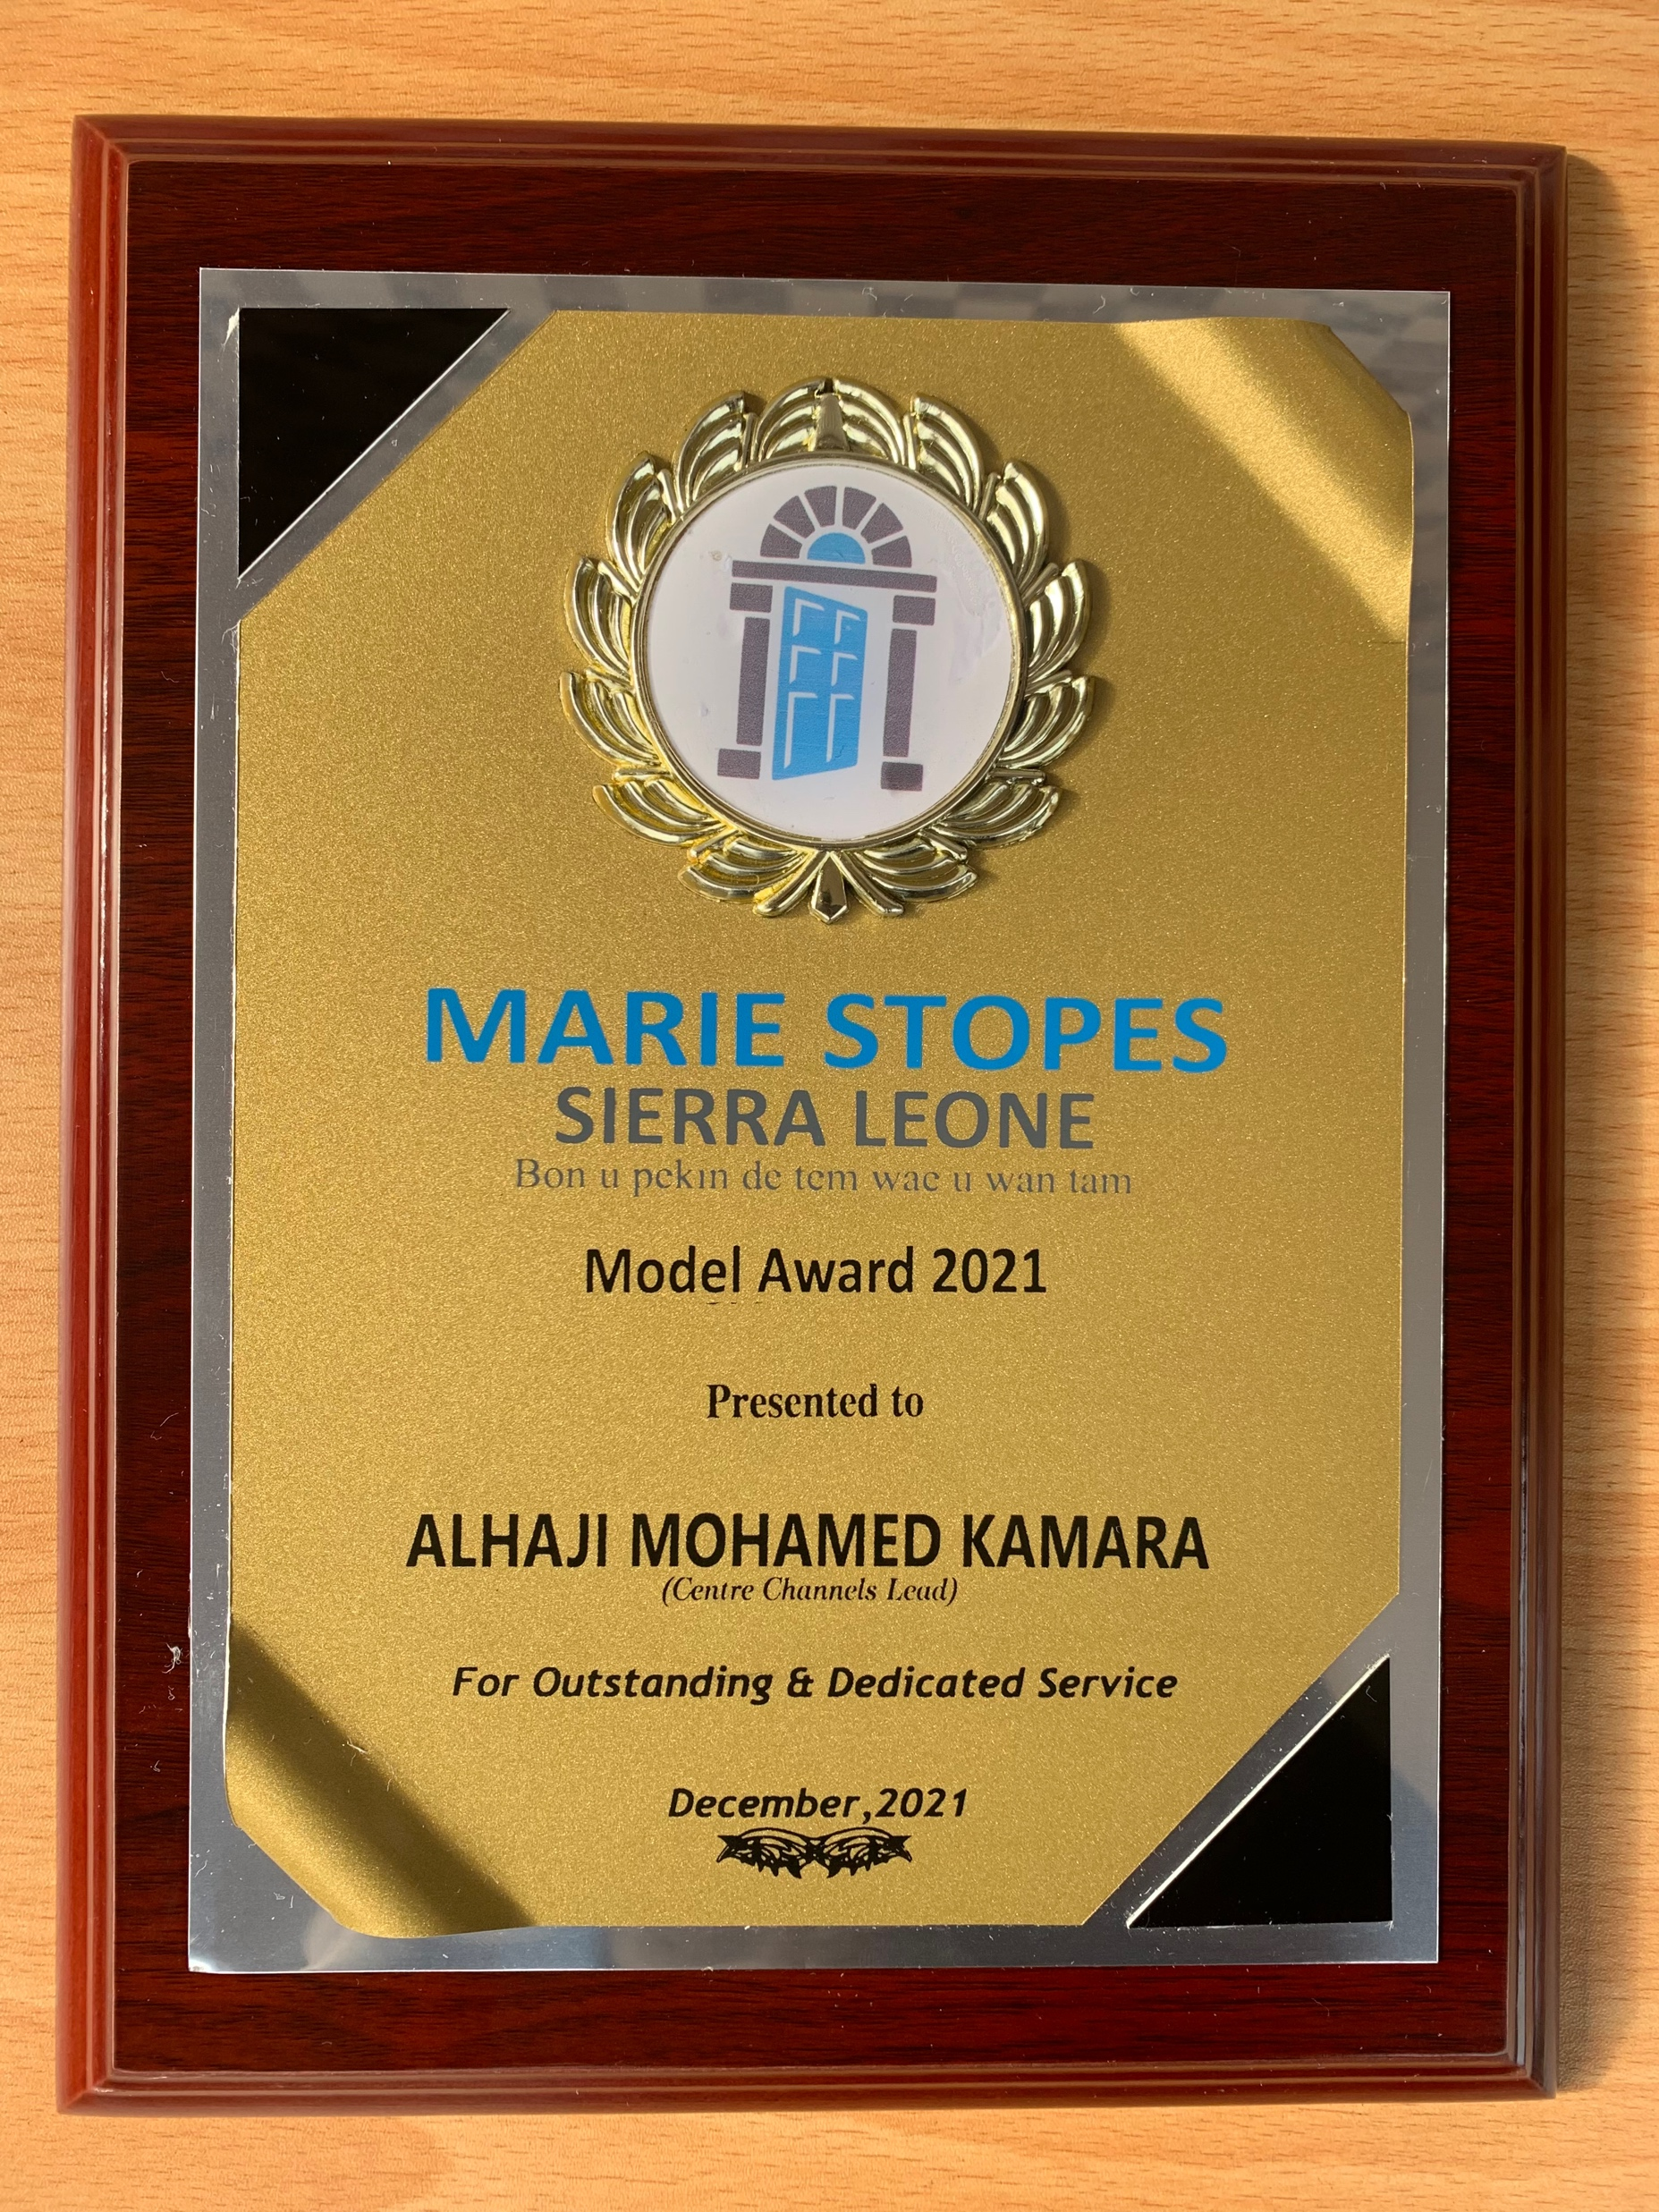
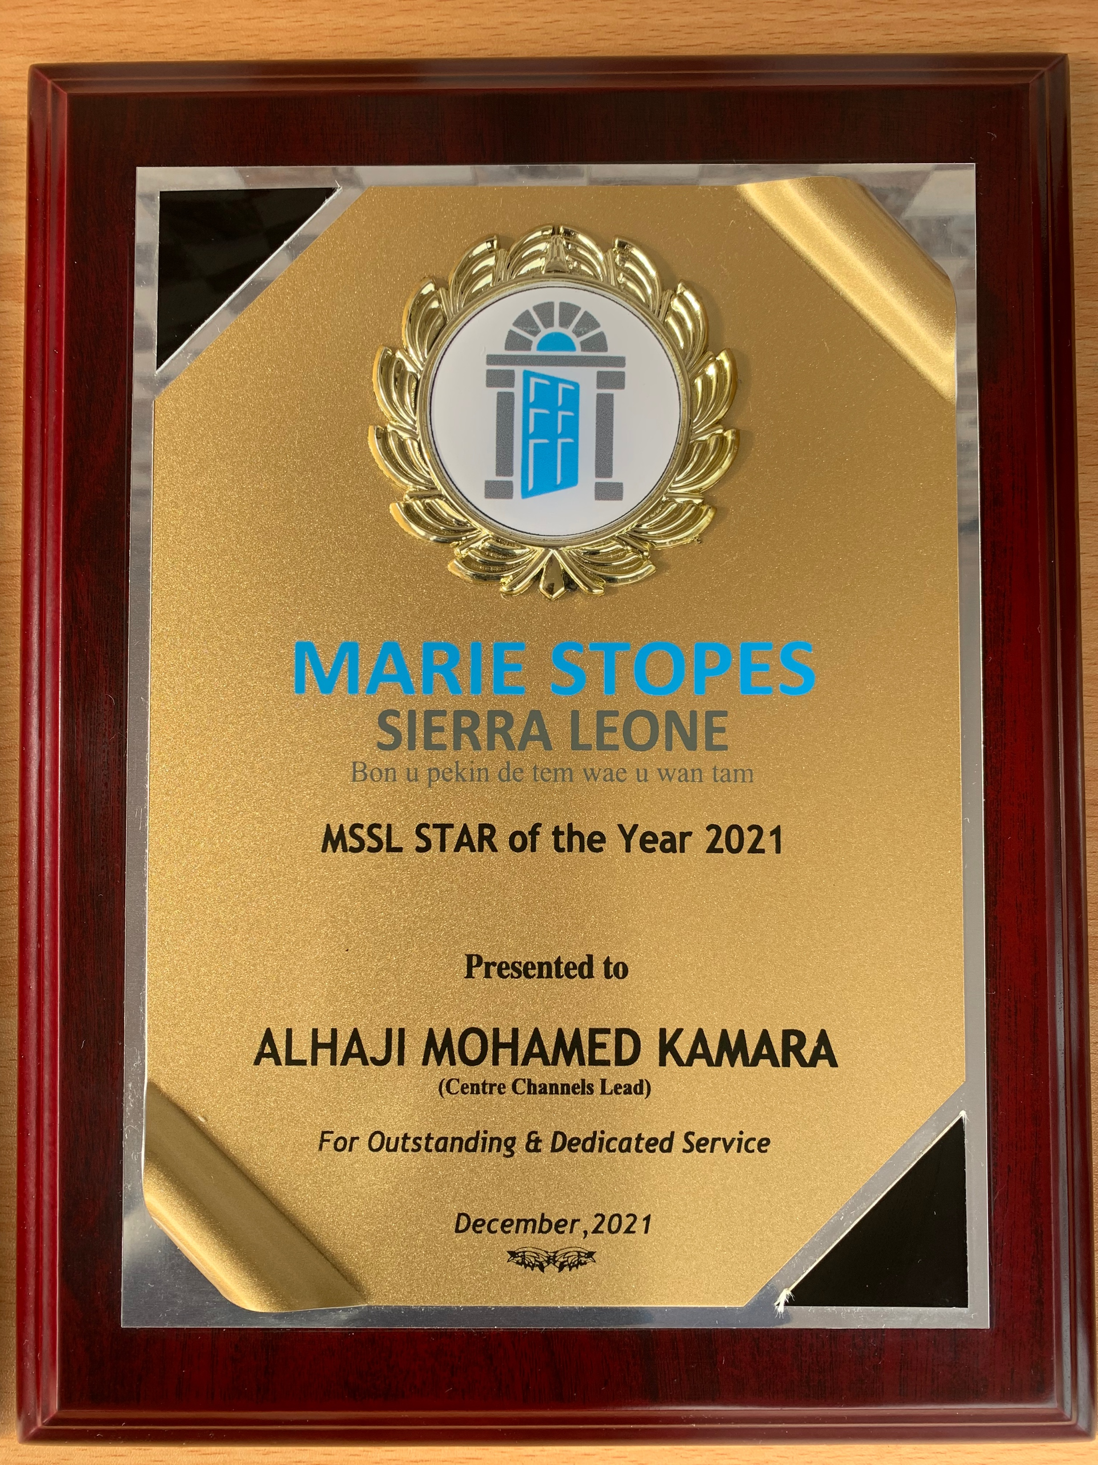
What was it like to work there?
  Challenging! KPIs (Targets) driven organisation
  Stigmatising – Healed from a Muslim family & District
  Restrictive environment for abortion services
  Fulfilling serving women and girls
  Networking opportunities with both local & international colleagues
  Travels & Exploring (ICPD25)
  Learning opportunity
  Recognition, promotions and Awards!!
Awards for outstanding performance

Slide 6
Personal story
Why a career in public health?
My Country’s poor health indicators – MMR, IMR
Health Workforce Gap in Sierra Leone
Fragile Health system – Post Conflict nation, repeated epidemics
Contribute to national development
Why LSHTM?
Reputation
Opportunity –Networking, collaboration, study opportunity
Brand

Slide 7
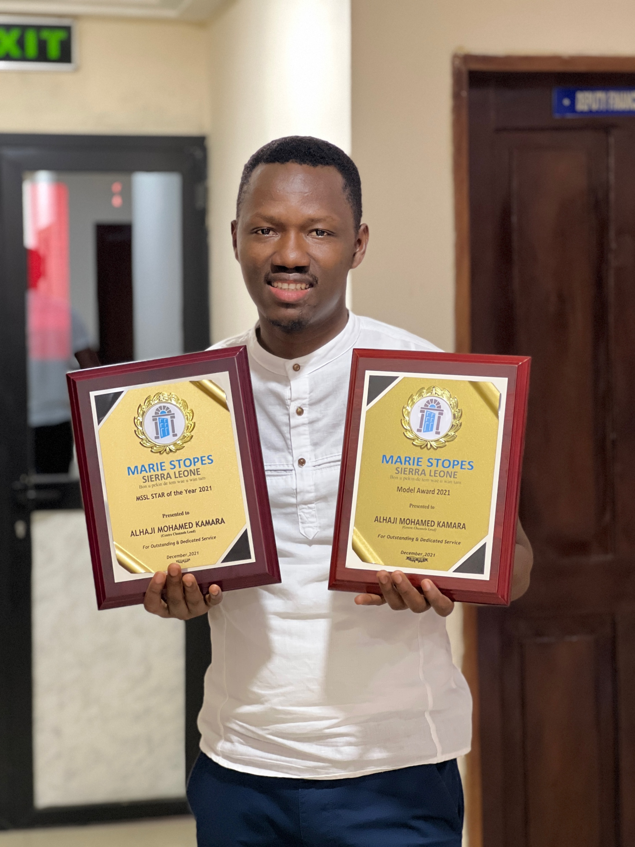
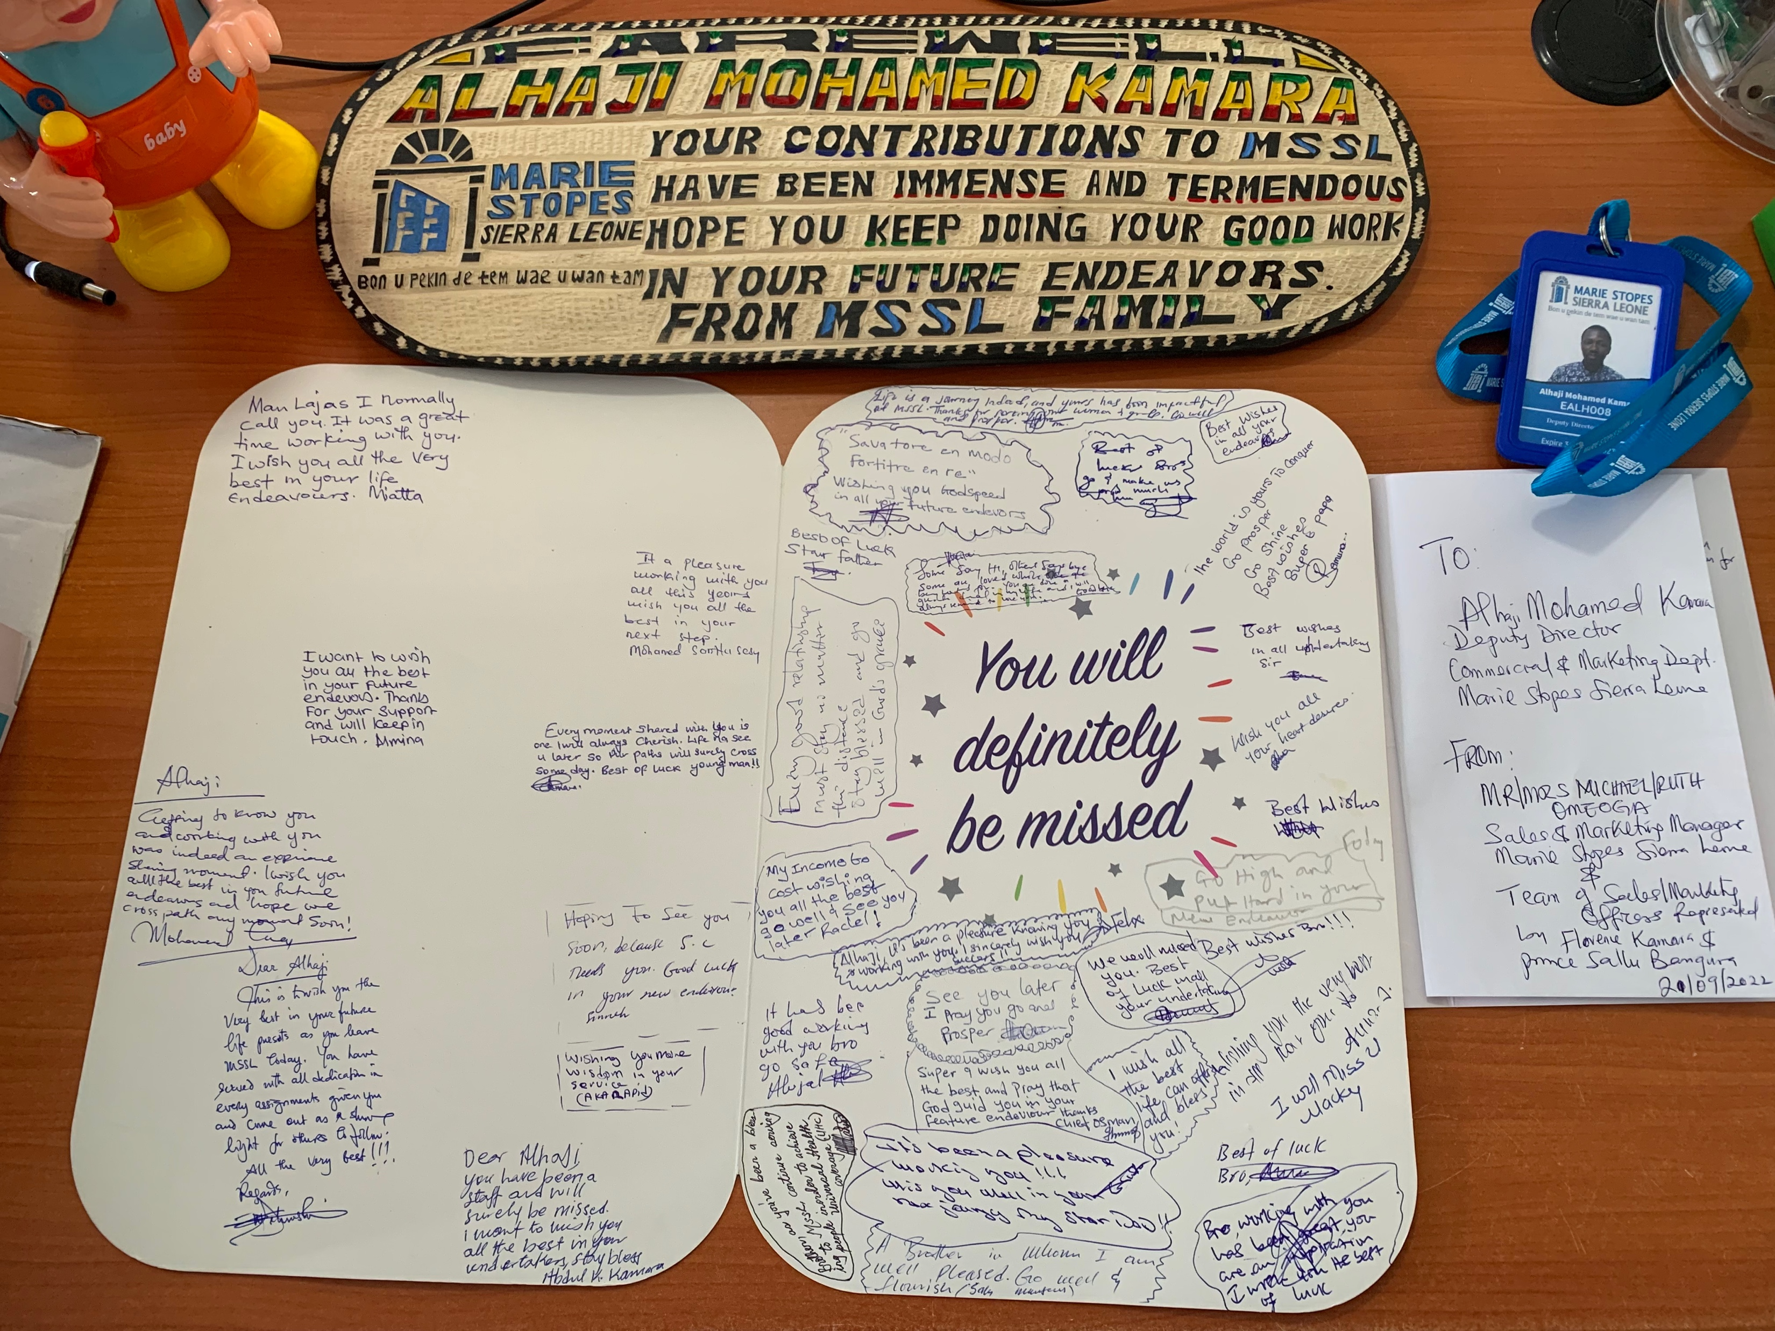
Achievement
  The digitalisation of the health system – EHR
  Solar Panel introduction – Electricity Challenge
  Rebranding and Improving our Laboratories & Clinic infrastructure
  Cabinet papers signed by the Minister of Health
Awards and Farewell gift

Slide 8
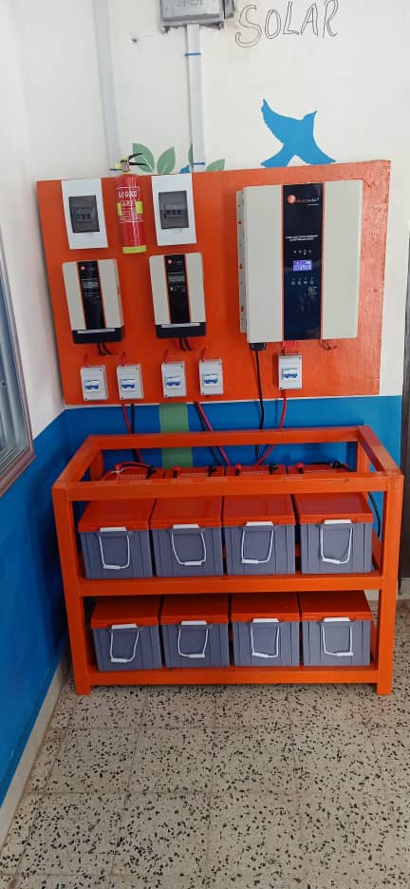
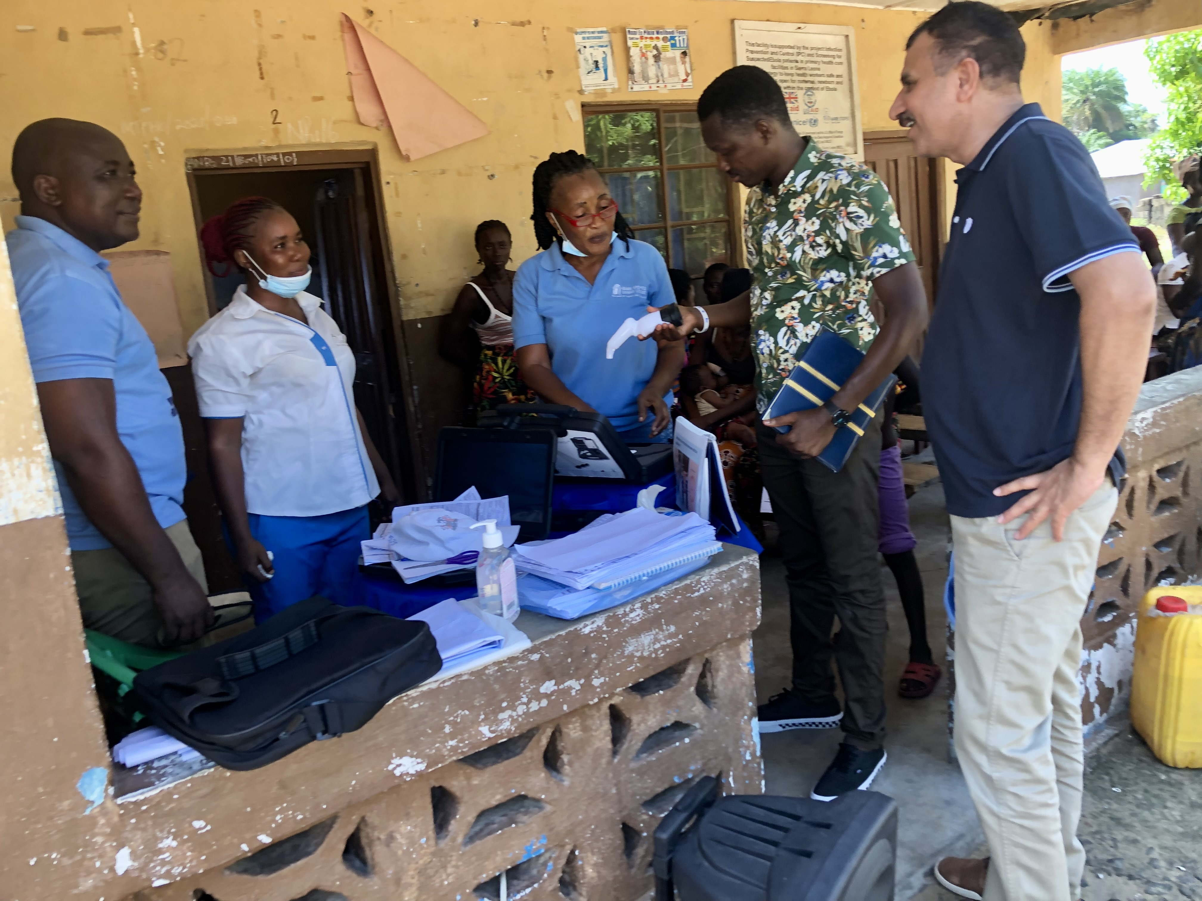
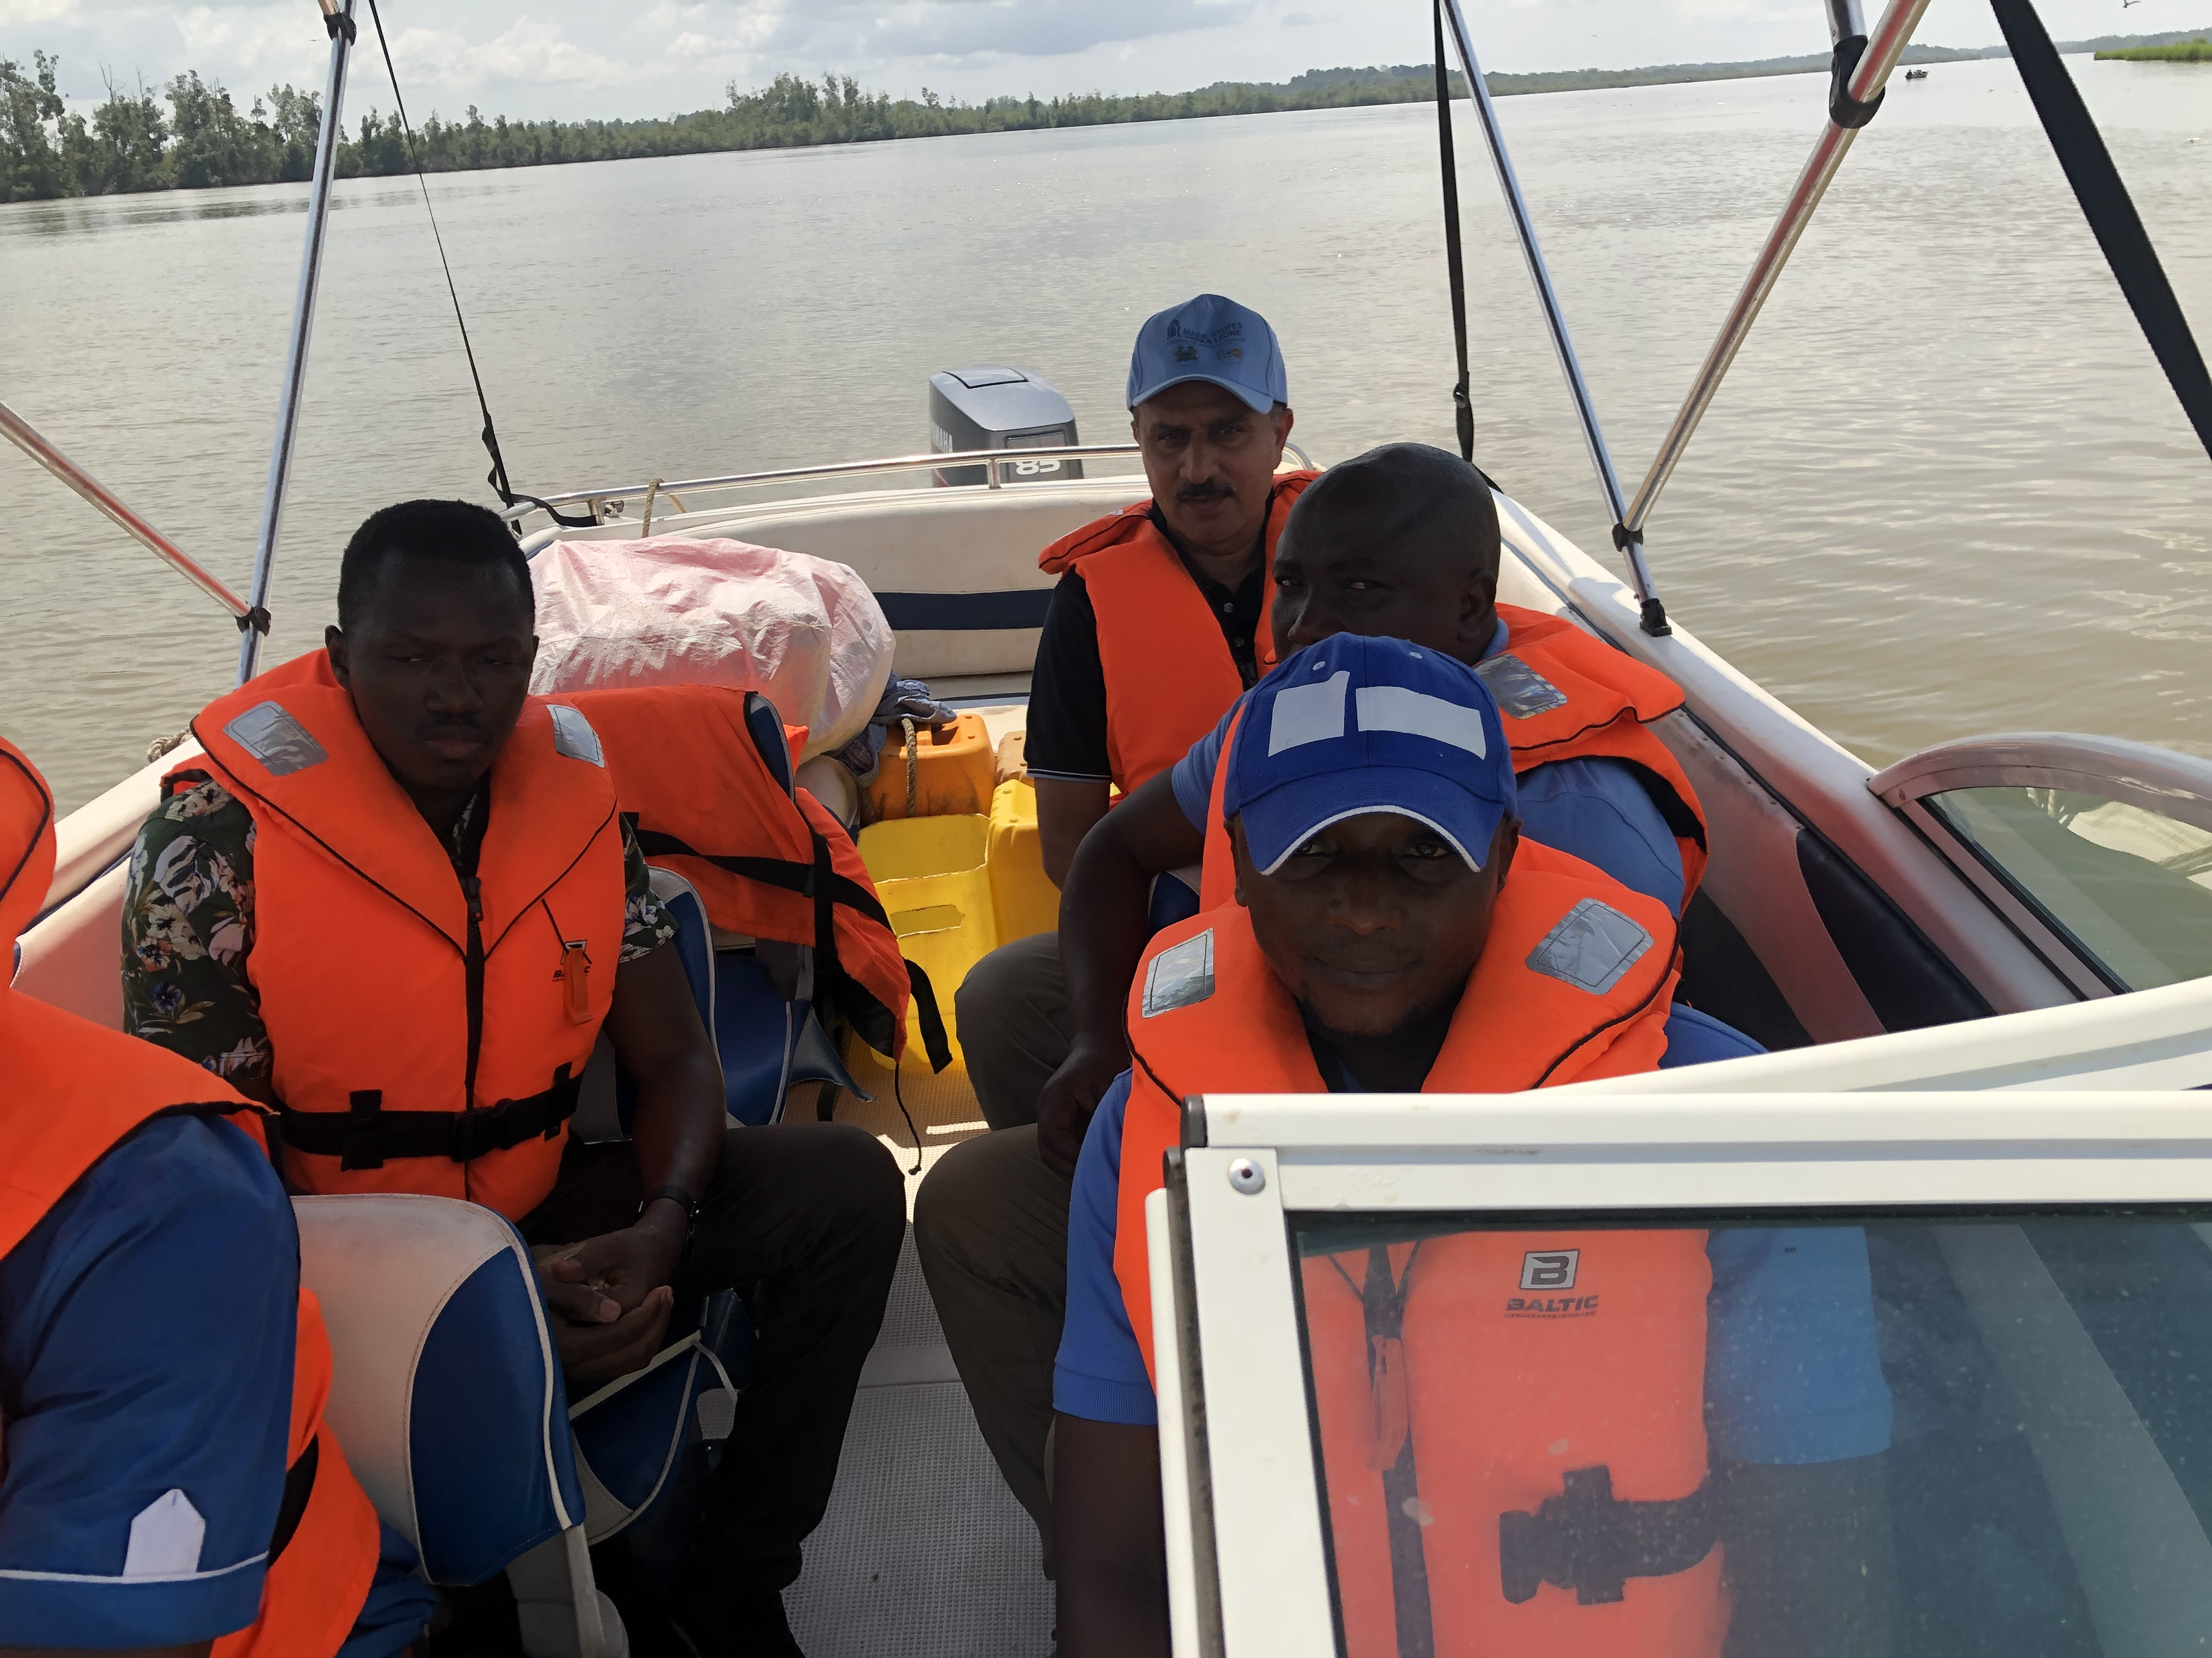
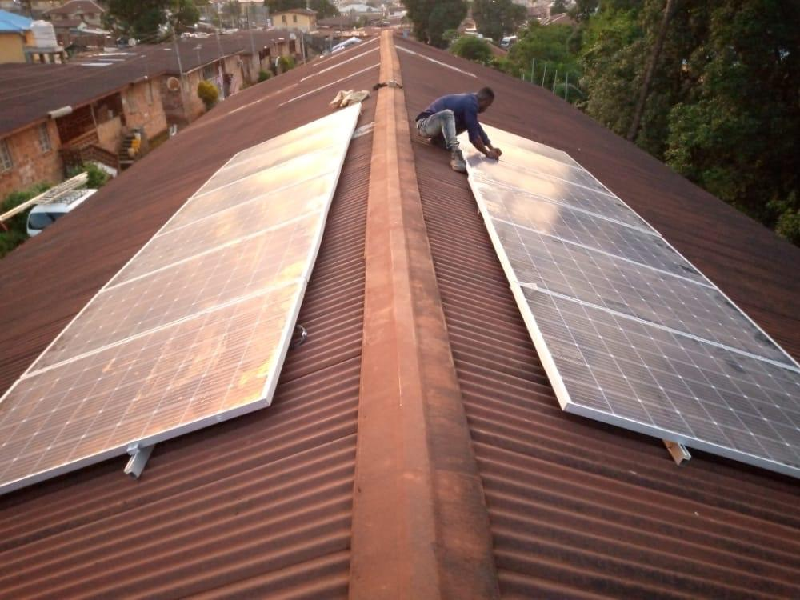
Achievement
Solar Panel Installation
Field Visit to an island

Slide 9
Career Plan
Research – Focusing on Maternal health & SRH
Working with UNFPA, WHO, UNICEF
Support Health System Strengthening – Epidemic Preparedness & Response
Teaching!
Advice
Be passionate about what you do
Be courageous and determined to change society
Learn to do things differently – Engage, ask, learn, take time
Push boundaries!
Play the office politics!

Slide 10
THANK YOU

