Slide 1

Programme specific careers session
Josh Phillips,
Careers Consultant

Slide 2

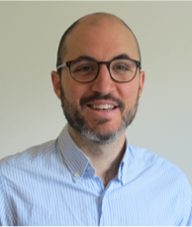
Why this session?
Requests from last year’s students:
Programme specific sessions
Better awareness of support services
Contact us:
Careers@lshtm.ac.uk
Fiona Telford – Mondays and Tuesdays
Josh Phillips – Wednesdays, Thursdays, Fridays

Slide 3
Aim for today
Aim: to equip you to make best use of LSHTM Careers to support your career decisions and progression into your next employment or further study.
Objectives: by the end of the session you will be able to:
Identify careers sessions and Moodle resources addressing your particular questions
Plan your next steps for career exploration/job hunting/presenting your skills effectively

Slide 4
Where do LSHTM graduates work?
University
Pharma
Consultancy
Government (Local/National)
Think Tank
International NGO
Local NGO
Supranational Organisation
United Nations
NICE
Local Authority Public Health Department
Universities (in UK and elsewhere in the world)
WHO
CHAI
GSK
Civil Service
The Health Policy Partnership
Novartis
Public Health England
Hospitals (in UK and elsewhere in the world)
Action against Hunger
Tearfund
The Felix Project

Slide 5
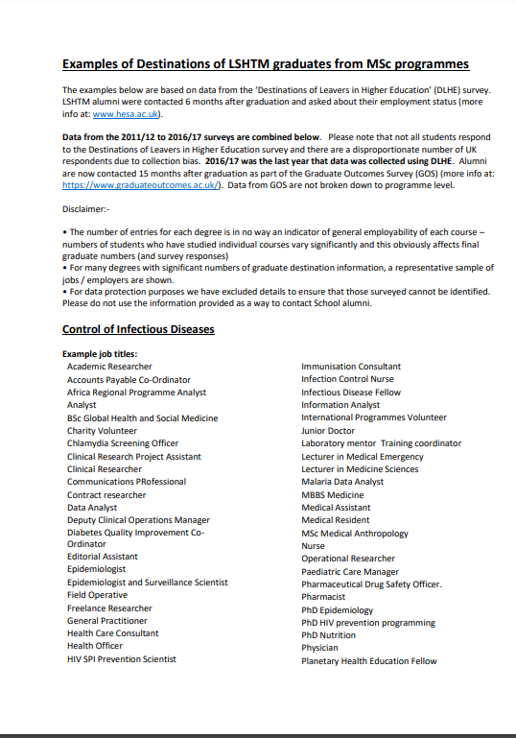
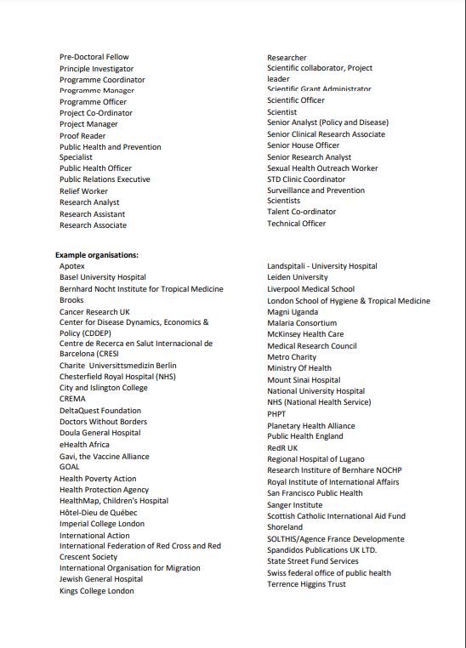
Where do LSHTM graduates work?
Moodle link here

Slide 6
What careers service resources can help you get there?

Slide 7
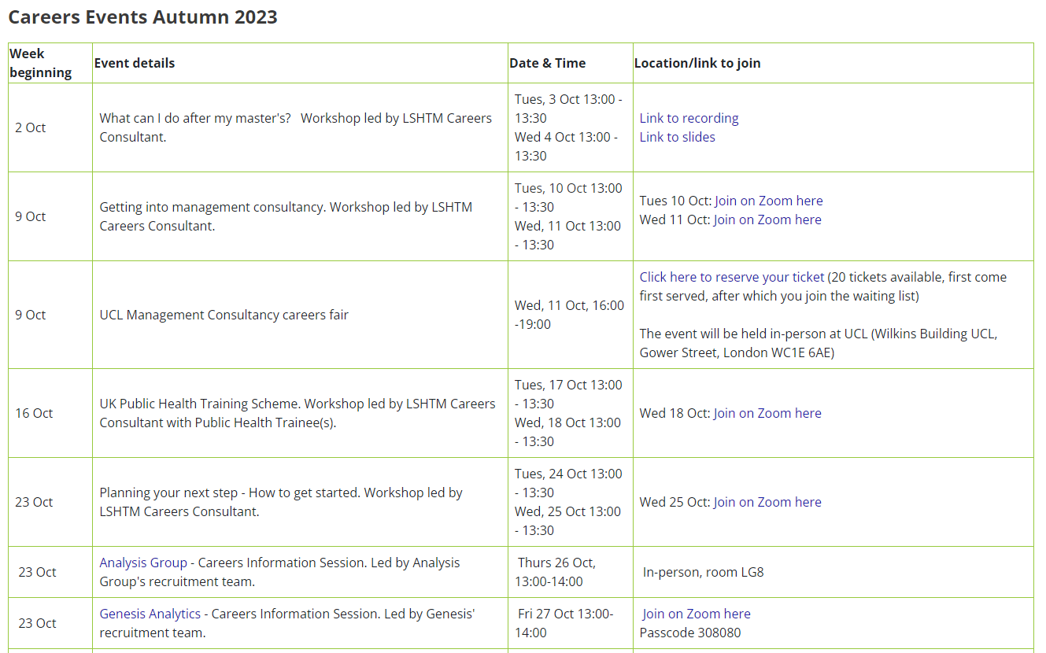
Attend a forthcoming careers event
Moodle link here

Slide 8
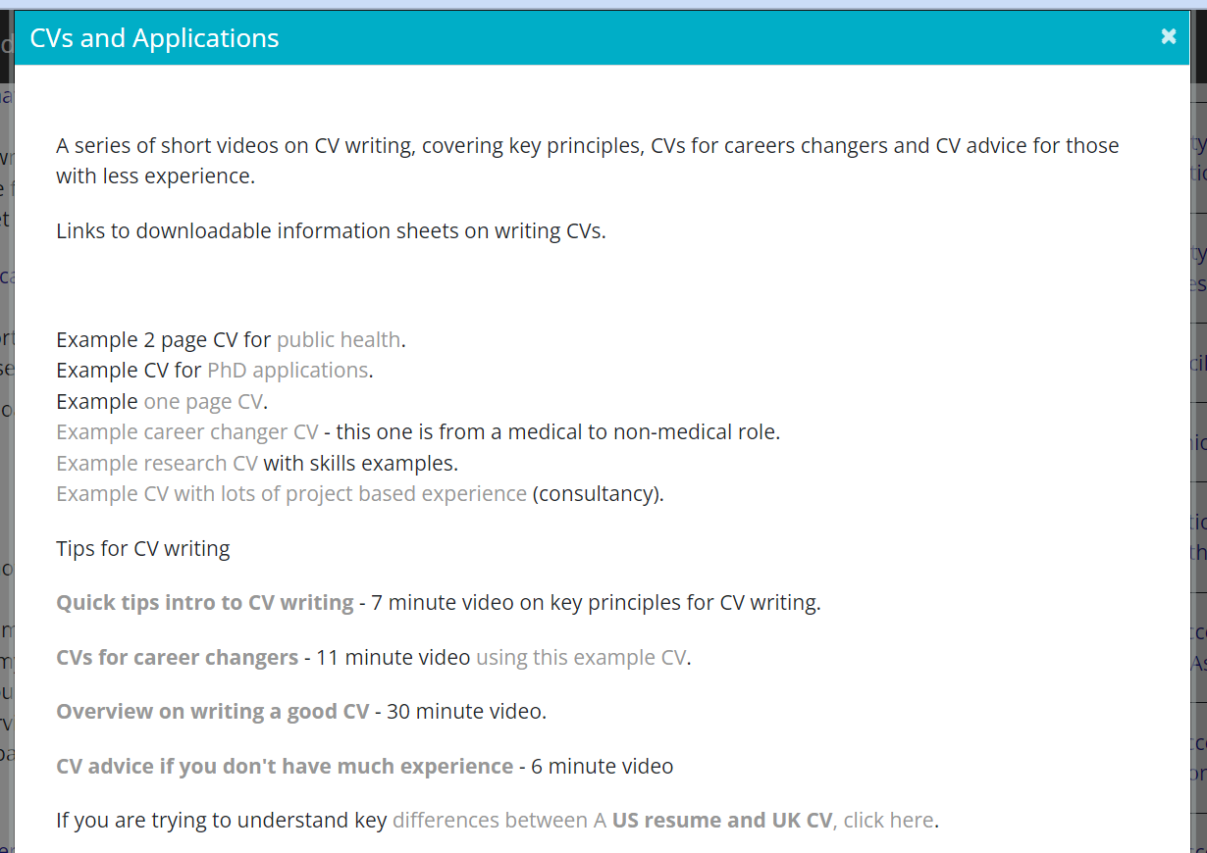
Use Moodle resources to improve my CV
Moodle link here
See also: 8 steps to a spectacular CV (video)

Slide 9
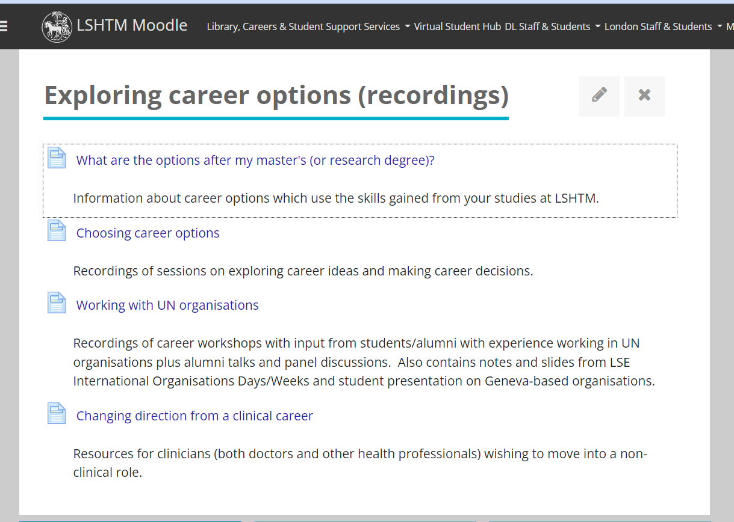
Listen to recordings about career options
Moodle link here

Slide 10
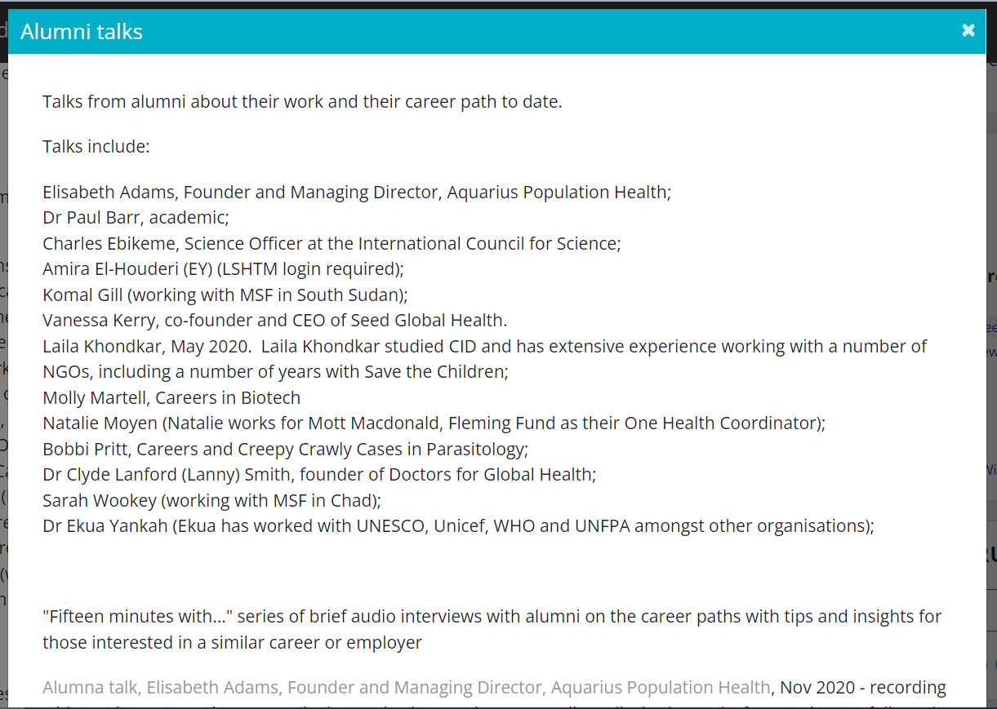
Watch/listen to alumni talk(s)
Moodle link here

Slide 11
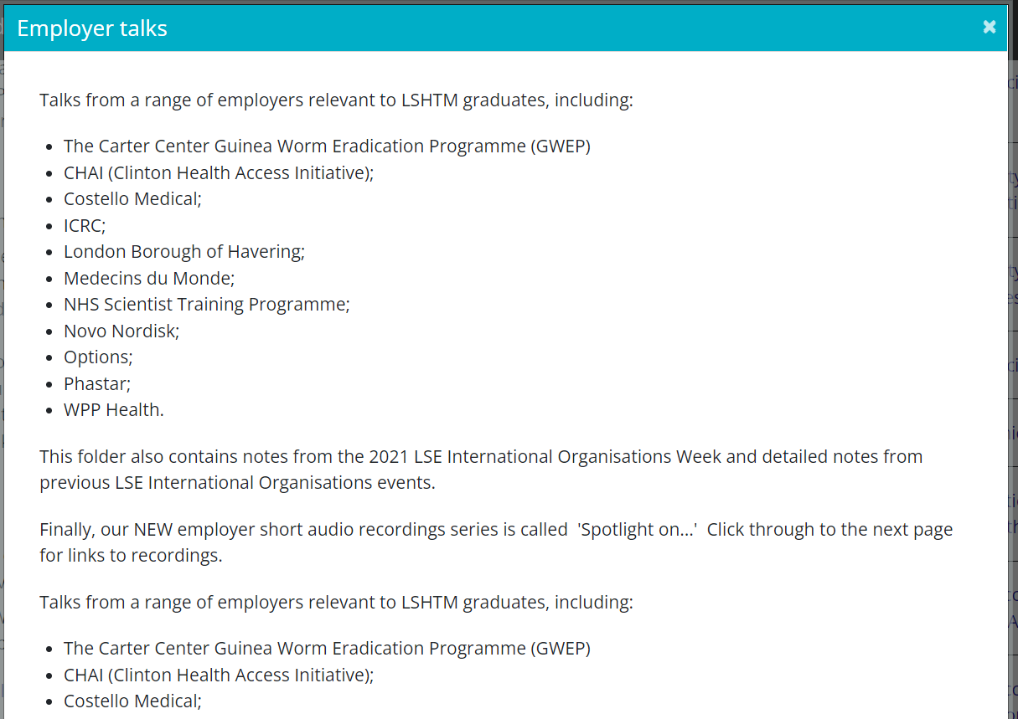
Watch/listen to employer talk(s)
Moodle link here

Slide 12
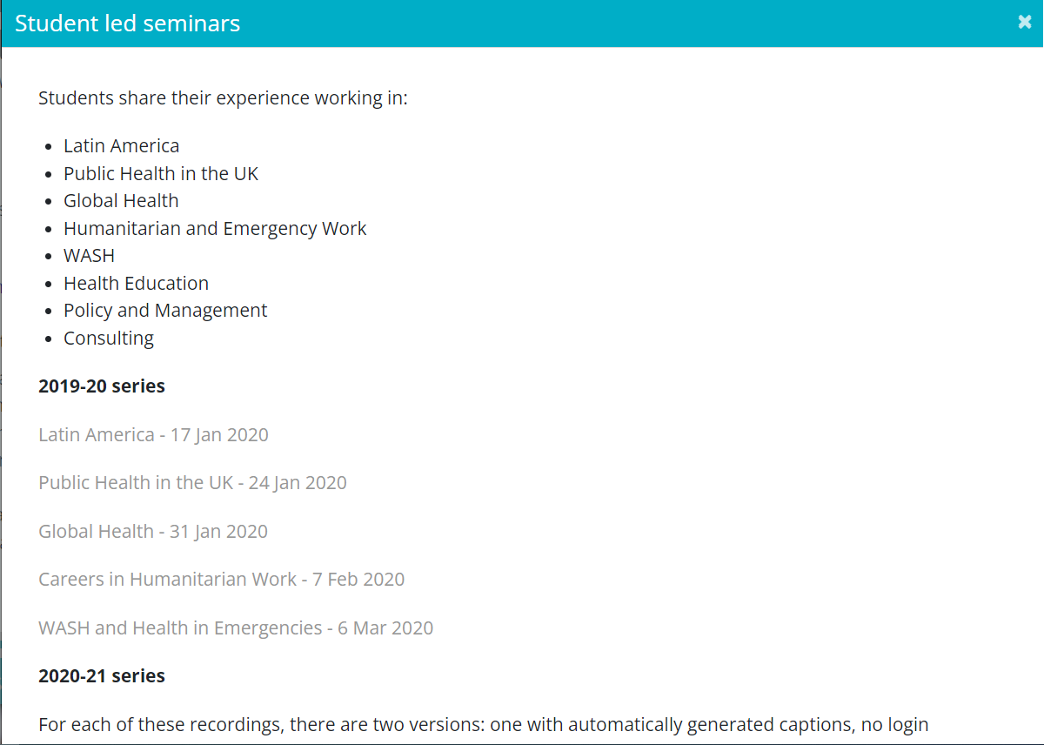
Watch/listen to student led seminar recording(s)
Moodle link here

Slide 13
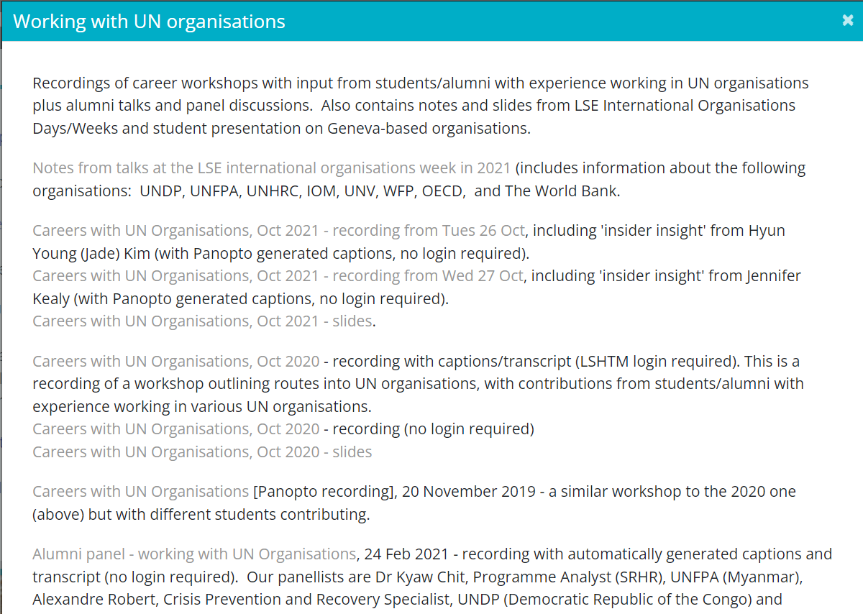
Explore the Moodle resources about UN organisations
Moodle link here

Slide 14
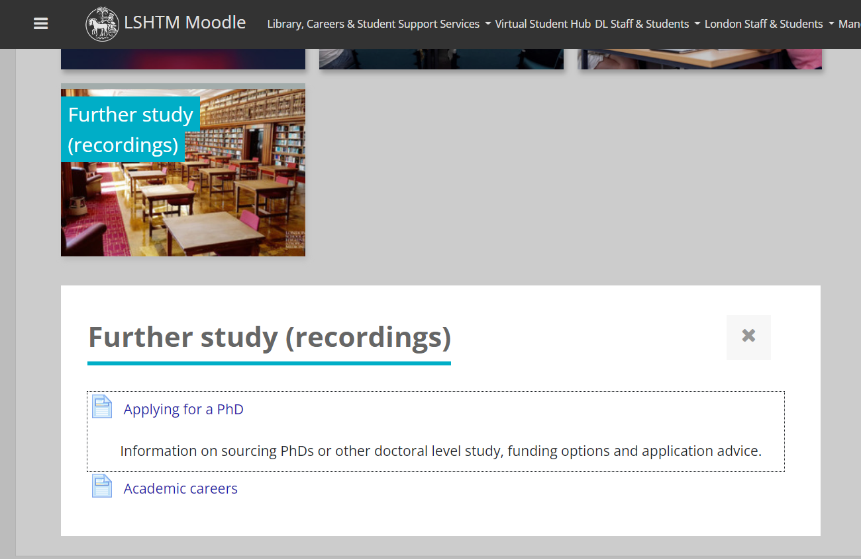
Explore the Moodle resources on further study
Moodle link here

Slide 15
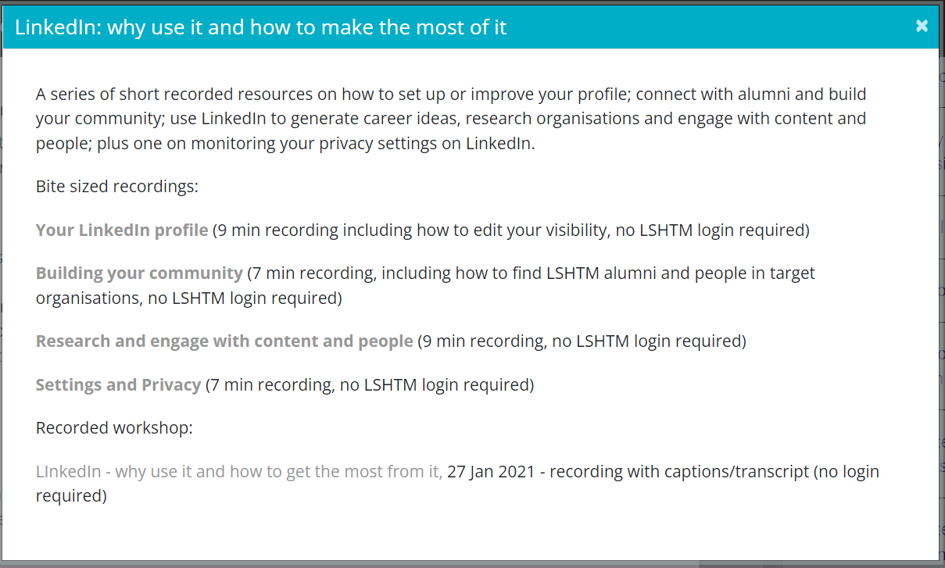
Watch/listen to materials on using LinkedIn
Moodle link here

Slide 16
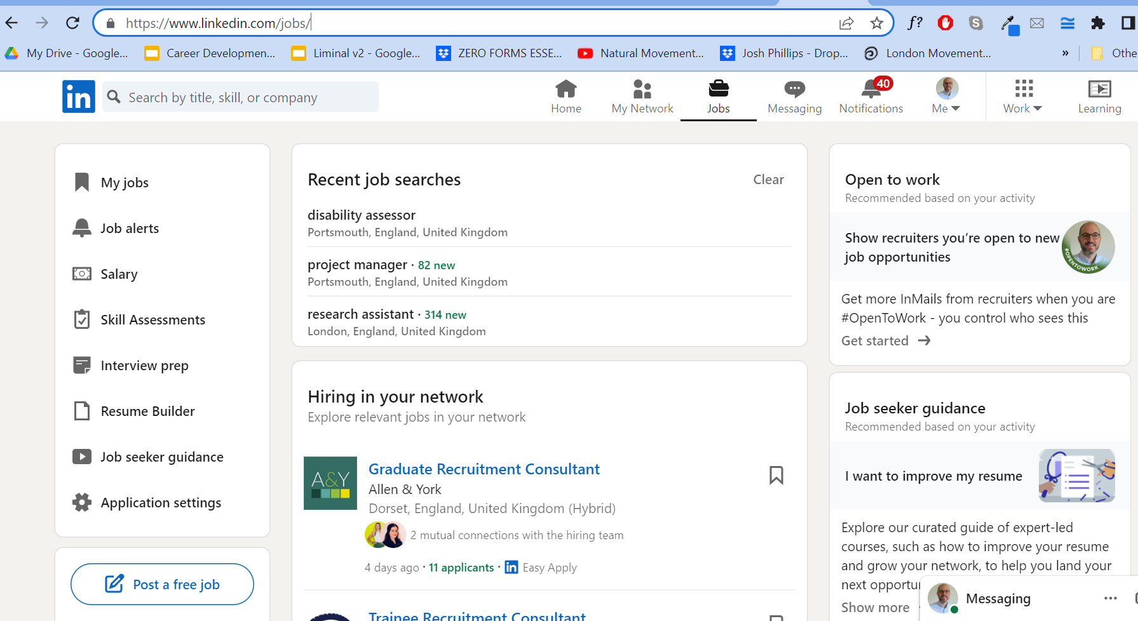
Use LinkedIn to research career ideas
LinkedIn here

Slide 17
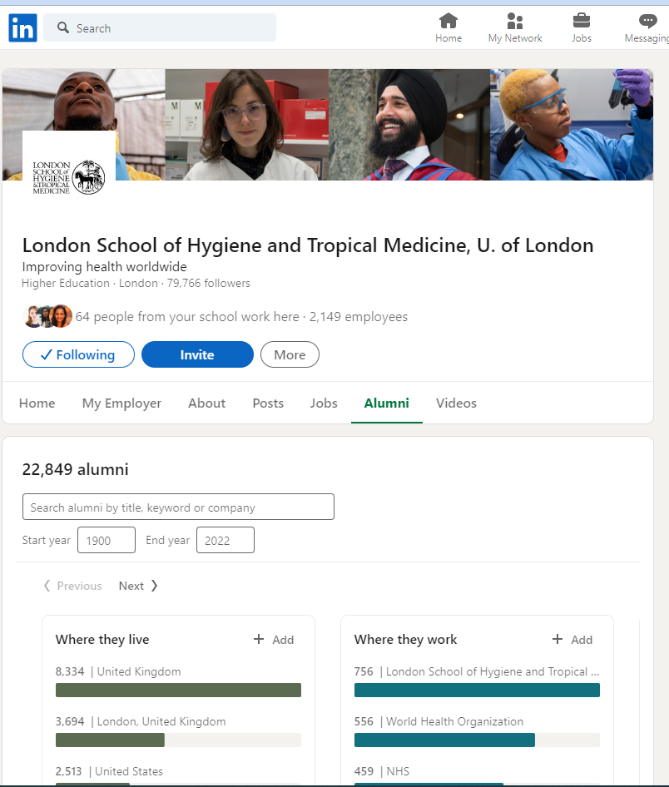
Use LinkedIn to connect with alumni
Go to LSHTM page
Click "Alumni" tab
Search by title, keyword or company
Connect/message with alumni

Slide 18
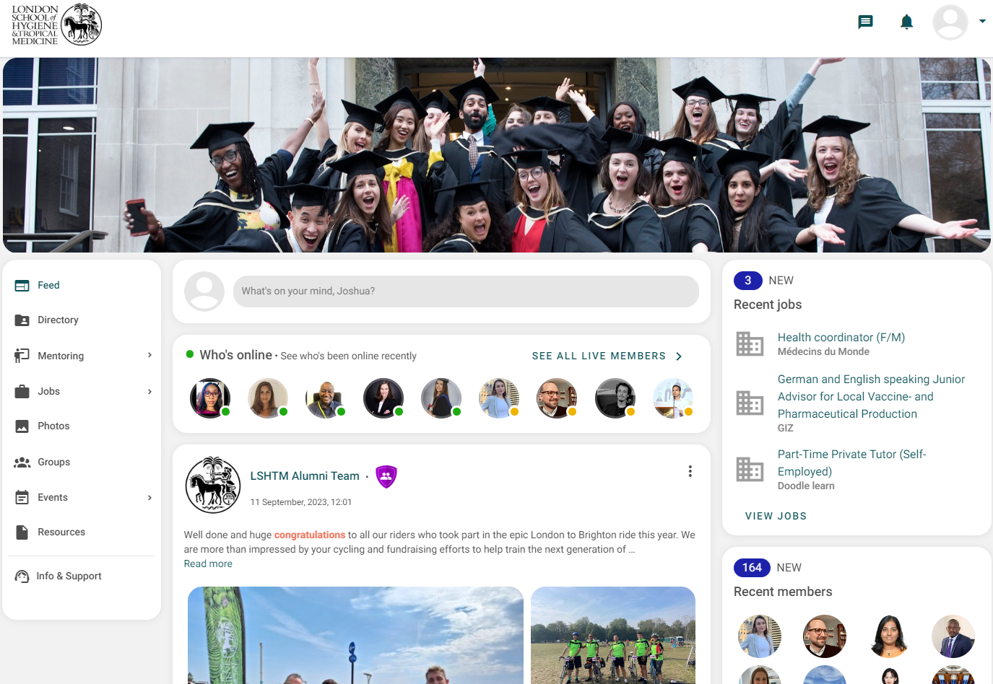
Use LSHTM Connect to connect with alumni
LSHTM Connect here

Slide 19
Connect with your classmates
Where
Whatsapp
Discord
Facebook
LinkedIn
LSHTM Connect
Why
Ask questions
Share skills
Share knowledge
Share opportunities
Gain confidence
Collaborate on projects/portfolios

Slide 20
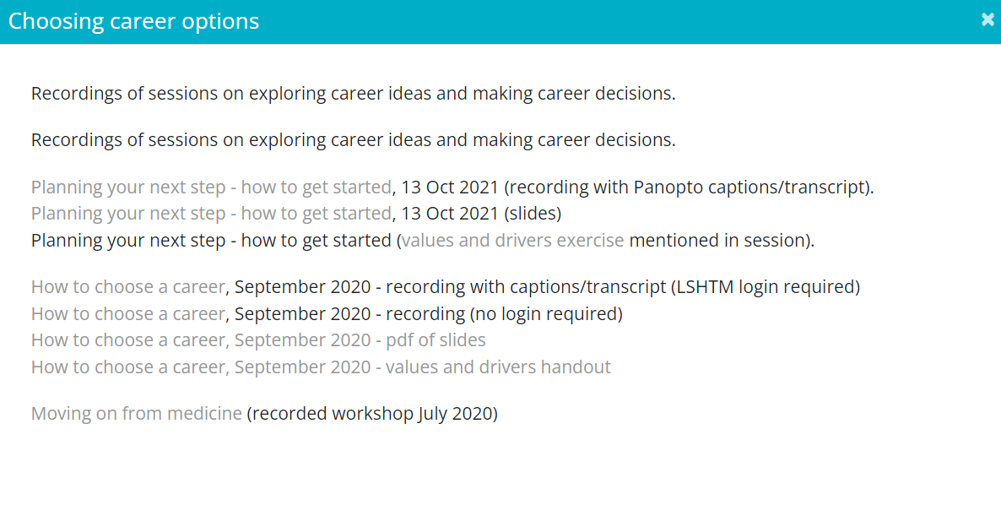
Reflect on your priorities for your career
Moodle link here

Slide 21
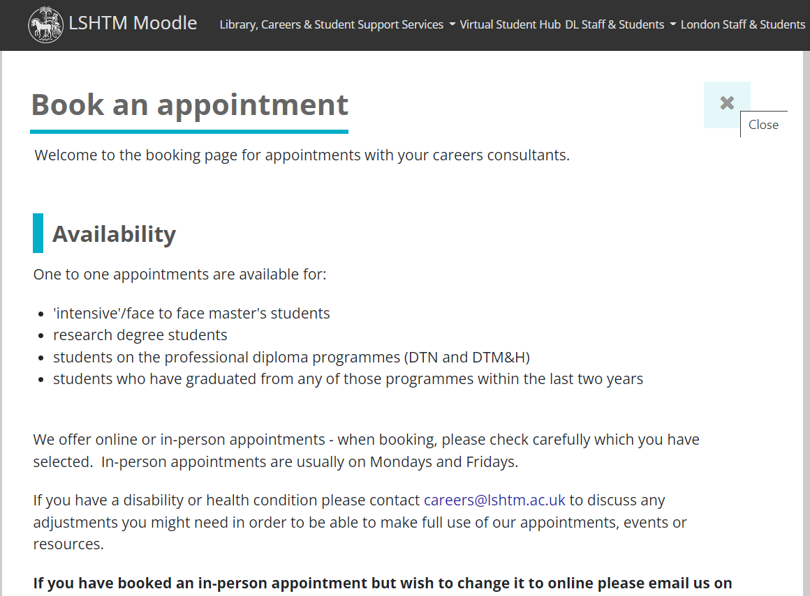
Book a one-to-one appointment with a careers consultant
Moodle link here
Book online
30mins for a general appointment
45mins for a practice interview
Online and face-to-face appointments
Note: you have access to 1-to-1 appointments for up to 2 years after graduation.

Slide 22
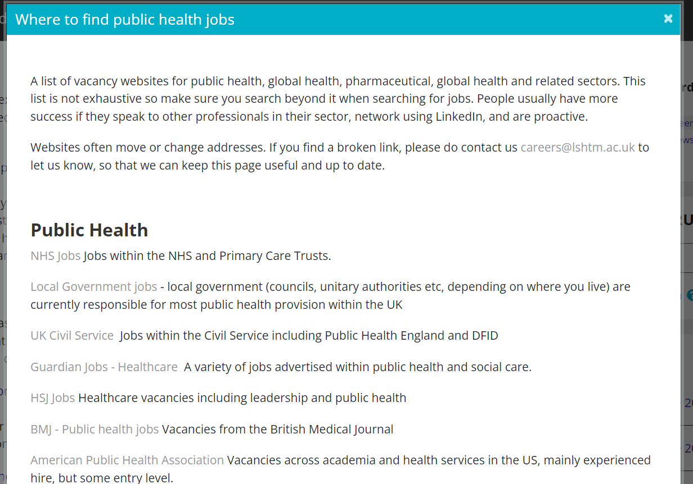
Start looking at job listings
Moodle link here
See also:
LSHTM Careers Job Listing (RHS of Moodle)
LinkedIn
Google Jobs
Indeed
Glassdoor
Company websites

Slide 23
Aim for today
Aim: to equip you to make best use of LSHTM Careers to support your career decisions and progression into your next employment or further study.
Objectives: by the end of the session you will be able to:
Identify careers sessions and Moodle resources addressing your particular questions
Plan your next steps for career exploration/job hunting/presenting your skills effectively

Slide 24
Feedback form
https://forms.office.com/r/hQzRwyxdni

Slide 25
Questions?

Slide 26
Thank you!

