Slide 1


Novo Nordisk Graduate Programme
London, 10th November 2020
VILJA STEHLE PHILIP VAN BERKOM PAULINA FORSBERG
Procurement Graduates Denmark
Notes:
Text slide
Image left square
Life-changing careers
P&O
People and organization

Slide 2
Today’s agenda
1
About Us
2
Novo Nordisk at a Glance
3
About the Graduate Programme
4
Q&A
Notes:
Strengthen pipeline of potential future managers + specialist, acceleration/fast track programme + strong employer brand with young talent, helps NN attract and retain the talent that is needed to succeed in the future (same purpose across programmes)

Slide 3
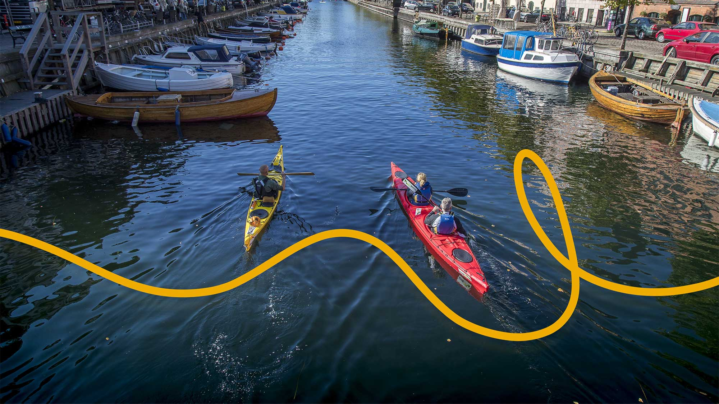
Who are we?
Notes:
Title slide
Front page
First page
Life-changing careers
P&O
People and organization

Slide 4
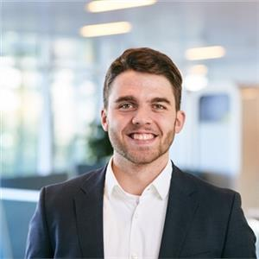
Victor Meeus
4
Global Market Access Graduate
Career & Education
My current role
During quarantine
University of Exeter, Business
and Management with
Industrial Experience
Placement Year at IBM
Watson Health
LSE, MSc International Health Policy (Health Economics)
GEPA EAST
Health Economic
Modelling on Early
Pipeline Assets
Providing payer voice
to early trial phase assets
Finished my Master’s thesis
Leisure reading
New outdoor activities
Theme #2
Theme #3
Add text
Add text
LinkedIn: /victormeeus
Email: vtmu@novonordisk.com
Notes:
Short about my background and journey in Novo Nordisk.
I have been with the company for almost 7 years, starting out in TA as a recruitment partner in Product Supply, the manufacturing part of Novo.
I graduated from CBS in 2010 with a master’s degree in HRM.
I my current role i Early Talent & Outreach I’m responsible for Global Talent Attraction, positioning NN as prepared employeer – I travell around the world ( at least I did before this global Corona outbreak hit us) to tell about the awesome career opportunities we offer in Novo Nordisk.
During this Quarentine:
I navigate working from home and at the same time taking care of my to small kids. That is one of the most challenging things I have tried. But we managed. Luckily they are both back in day care now. It makes it easier to focus, But i have also really enjoyeed all the time with them and my husband.
My favorite new Corona hobby – it to do crossfit outside with a friend – we bring our kettlebells and work out for one our – afterwards we jump into the sea. It pretty cold but amazing and you get the best feeling afterwards.

Slide 5
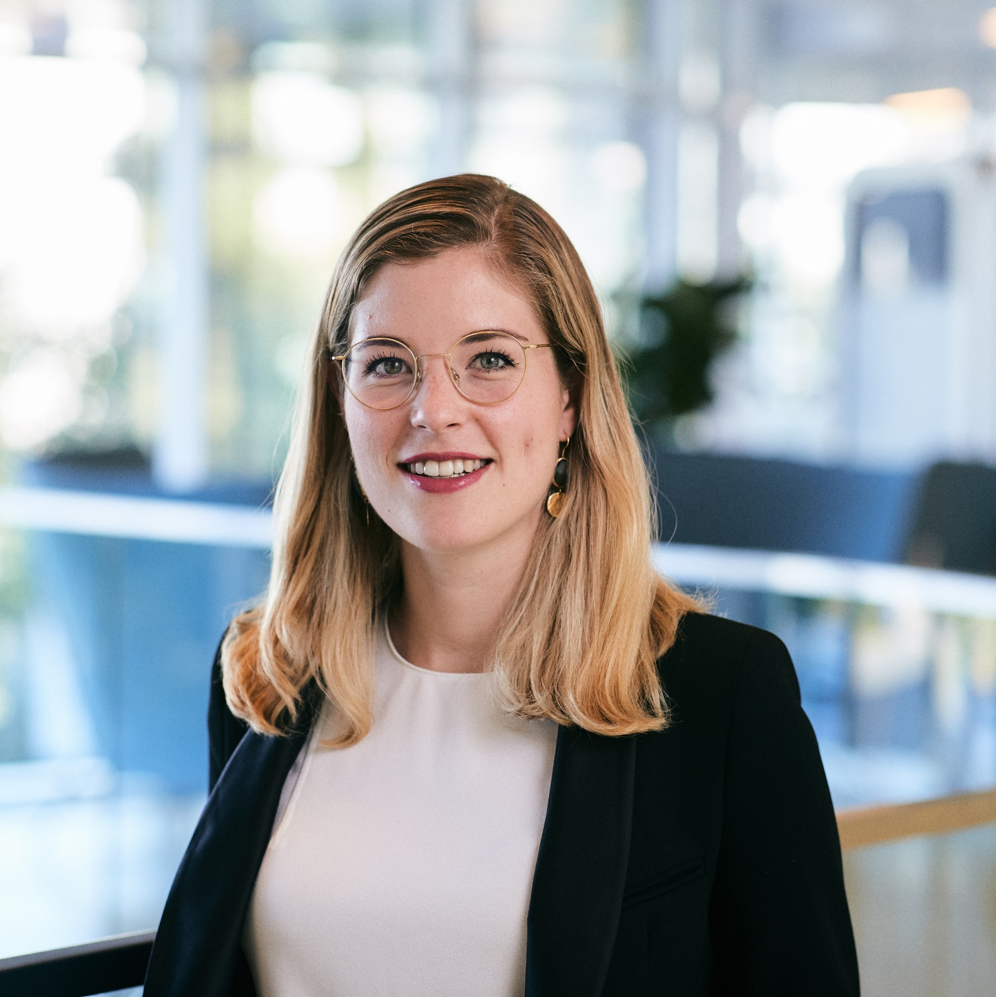
Alice Burckhardt
5
Global Business Processes Graduate
Career & Education
My current role
During quarantine
University of St. Gallen, International Affairs
Internship at Neodent, Brazil
LSE, MSc International Health Policy
Legal Department - Legal Operations
External Legal Counsel Management
Creating a guide to optimize supplier selection and minimize legal spend
Finished my Master’s thesis
Hiking in Switzerland
Spending time with family
Theme #2
Theme #3
Add text
Add text
LinkedIn: /in/alice-burckhardt-190a74a3/
Email: naeb@novonordisk.com
Notes:
Short about my background and journey in Novo Nordisk.
I have been with the company for almost 7 years, starting out in TA as a recruitment partner in Product Supply, the manufacturing part of Novo.
I graduated from CBS in 2010 with a master’s degree in HRM.
I my current role i Early Talent & Outreach I’m responsible for Global Talent Attraction, positioning NN as prepared employeer – I travell around the world ( at least I did before this global Corona outbreak hit us) to tell about the awesome career opportunities we offer in Novo Nordisk.
During this Quarentine:
I navigate working from home and at the same time taking care of my to small kids. That is one of the most challenging things I have tried. But we managed. Luckily they are both back in day care now. It makes it easier to focus, But i have also really enjoyeed all the time with them and my husband.
My favorite new Corona hobby – it to do crossfit outside with a friend – we bring our kettlebells and work out for one our – afterwards we jump into the sea. It pretty cold but amazing and you get the best feeling afterwards.

Slide 6

Novo Nordisk
Roshni
Roshni has type 1 diabetes
India

Slide 7
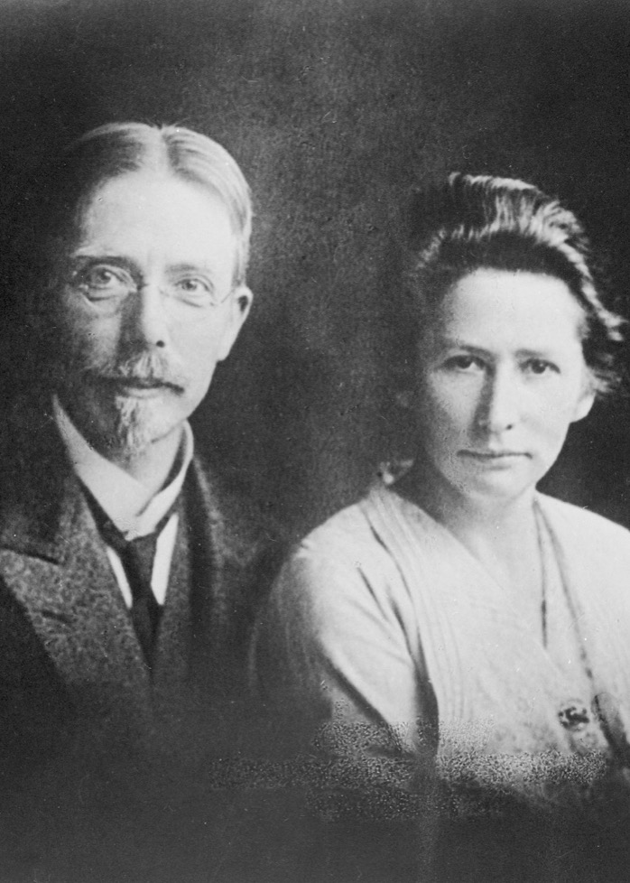
7
Founded
in 1923
Founded in Denmark in 1923 with a focus on diabetes, we have become one of the world’s leading healthcare companies.
Today, we are also using our capabilities to tackle unmet needs in serious metabolic diseases, such as obesity, and in rare blood and endocrine disorders.
August and Marie Krogh obtained permission to produce insulin in Scandinavia in 1922

Slide 8
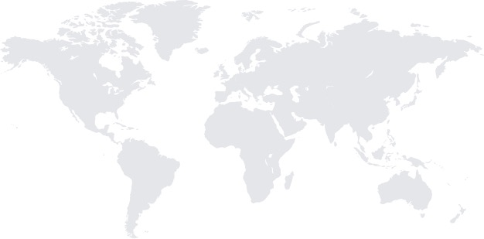


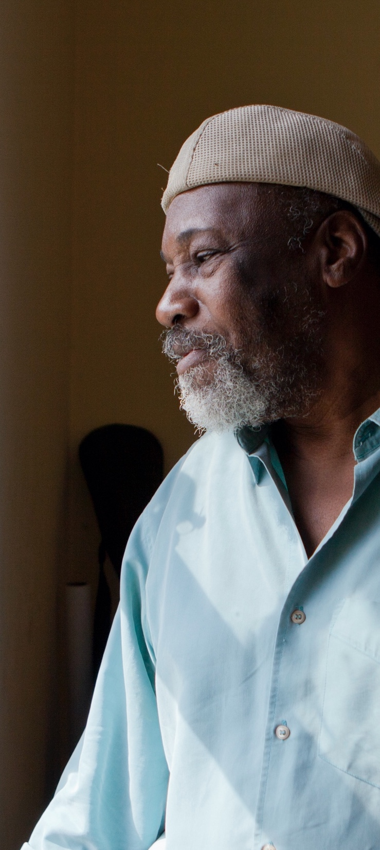
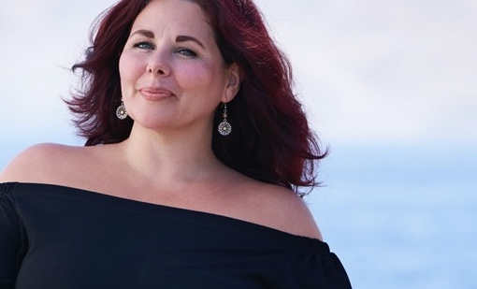

170
170
Supplier of nearly
Products marketed in
Total net sales
50%
30
Novo
Nordisk
at a glance
170
122
countries
billion DKK
of the world’s insulin
million people use our
diabetes care products
Affiliates in
R&D centres
in China, Denmark,
India, UK and US
About
80
43,500
Strategic production
sites in Denmark,
Brazil, China, France
and US
countries
employees
Growth
disorders
Diabetes
Novo Nordisk is a leading global
healthcare company, founded in 1923
and headquartered in Denmark.
Haemophilia
10
Our purpose is to drive change to defeat diabetes and other serious chronic diseases such as obesity
and rare blood and endocrine disorders.
We do so by pioneering scientific breakthroughs, expanding access to our medicines and working to prevent and ultimately
cure disease.
Among the world’s
largest pharma companies measured by market value¹
Obesity
Notes:
References:
MedWatch. Novo Nordisk is the world’s 6th largest pharma company by market value. 2 October 2019. Available at: https://medwatch.dk/secure/Top_picks_in_english/article11657489.ece
Accessed: February 2020.
Fact source: Novo Nordisk Annual Report 2019 and data on file.

Slide 9
9
170
80
Novo Nordisk markets its products
in 170 countries worldwide
Novo Nordisk affiliates
in 80 countries
Our global
presence
Corporate headquarters
Bagsværd, Denmark
North America Operations HQ
Plainsboro, NJ, US
International Operations HQ
Zurich, Switzerland
Strategic
production sites
Brazil, China, Denmark, France, US
R&D centres
China, Denmark, India, UK, US
Regional offices
  Beijing (China)
  São Paolo (Latin America)
  Tokyo (Japan)
  Copenhagen (North West Europe)
  Mainz (Germany)
  Zurich (South East Europe,
  Middle East & Africa
  Dubai (Asia & Pacific)

Slide 10

Chronic diseases
are an urgent global health challenge
Urgent global health challenge

Slide 11
Non-communicable diseases (NCDs) are the leading cause of death and disability globally¹
11
71%
of global deaths
in 2016 were due to NCDs¹
1. Roth GA, et al. Global, regional, and national age-sex-specific mortality for 282 causes of death in 195 countries and territories, 1980–2017: a systematic analysis for the Global Burden of Disease Study 2017. The Lancet. 2018;392(10159):1736–1788.

Slide 12

Four major NCDs drive the burden, accounting for 38 million deaths¹
12
Diabetes
Cardiovascular
diseases
Cancer
Chronic respiratory disease
1. Roth GA, et al. Global, regional, and national age-sex-specific mortality for 282 causes of death in 195 countries and territories, 1980–2017: a systematic analysis for the Global Burden of Disease Study 2017. The Lancet. 2018;392(10159):1736–1788.

Slide 13
Diabetes is a rapidly growing social challenge worldwide
13
The increasing global prevalence of diabetes ^{1,2}
51%
increase in number
of adults with diabetes
700 million
2045
adults with diabetes²
463 million
2019
adults with diabetes²
285 million
2010
adults with diabetes¹
1. International Diabetes Federation. IDF Diabetes Atlas, 5th edn. Brussels, Belgium: International Diabetes Federation. 2011.
2. International Diabetes Federation. IDF Diabetes Atlas, 9th edn. Brussels, Belgium: International Diabetes Federation. 2019.

Slide 14

Obesity is a global pandemic
14
650M
adults live with
obesity²
Obesity is linked to multiple health complications, including heart disease, type 2 diabetes and certain types of cancers¹
120M
children and adolescents live with obesity²
45%
of people with obesity are not diagnosed³
1. Yuen M, Earle R, Kadambi N, et al. A systematic review and evaluation of current evidence reveals 195 obesity-associated disorders. Poster abstract presentation at: The Obesity Society Annual Meeting at Obesity Week 2016; Oct. 31 - Nov. 4, 2016; New Orleans.
2. World Health Organization. Obesity and Overweight Fact Sheet no. 311. Available at: http://www.who.int/mediacentre/factsheets/fs311/en/ Accessed: November 2018.
3. Kaplan LM, Golden A, et al. Perceptions of Barriers to Effective Obesity Care: Results from the National ACTION Study. Obesity. 2018;26(1):61-9.

Slide 15
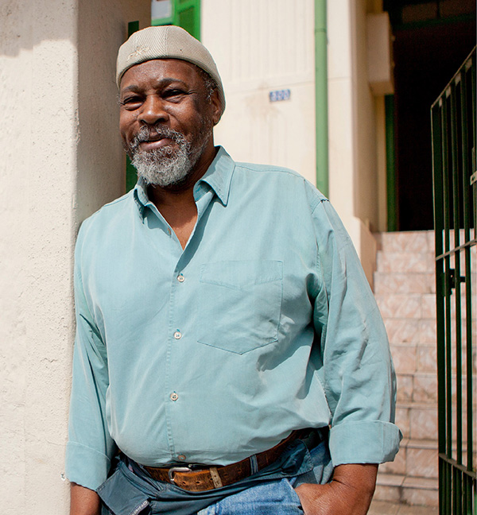
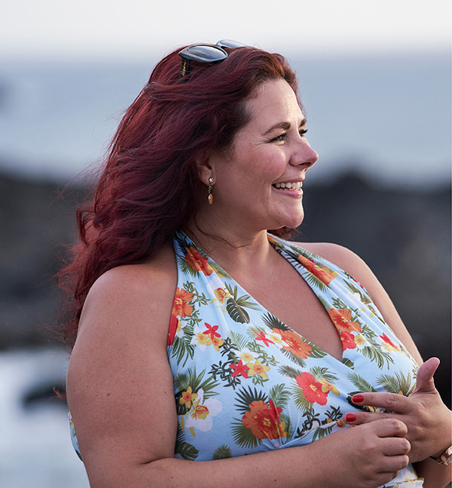

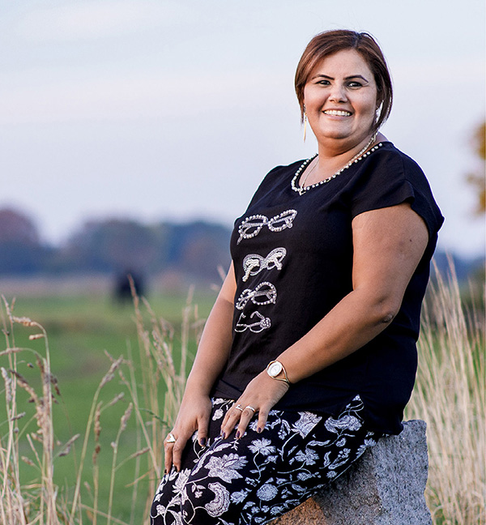
Our corporate strategy

Slide 16
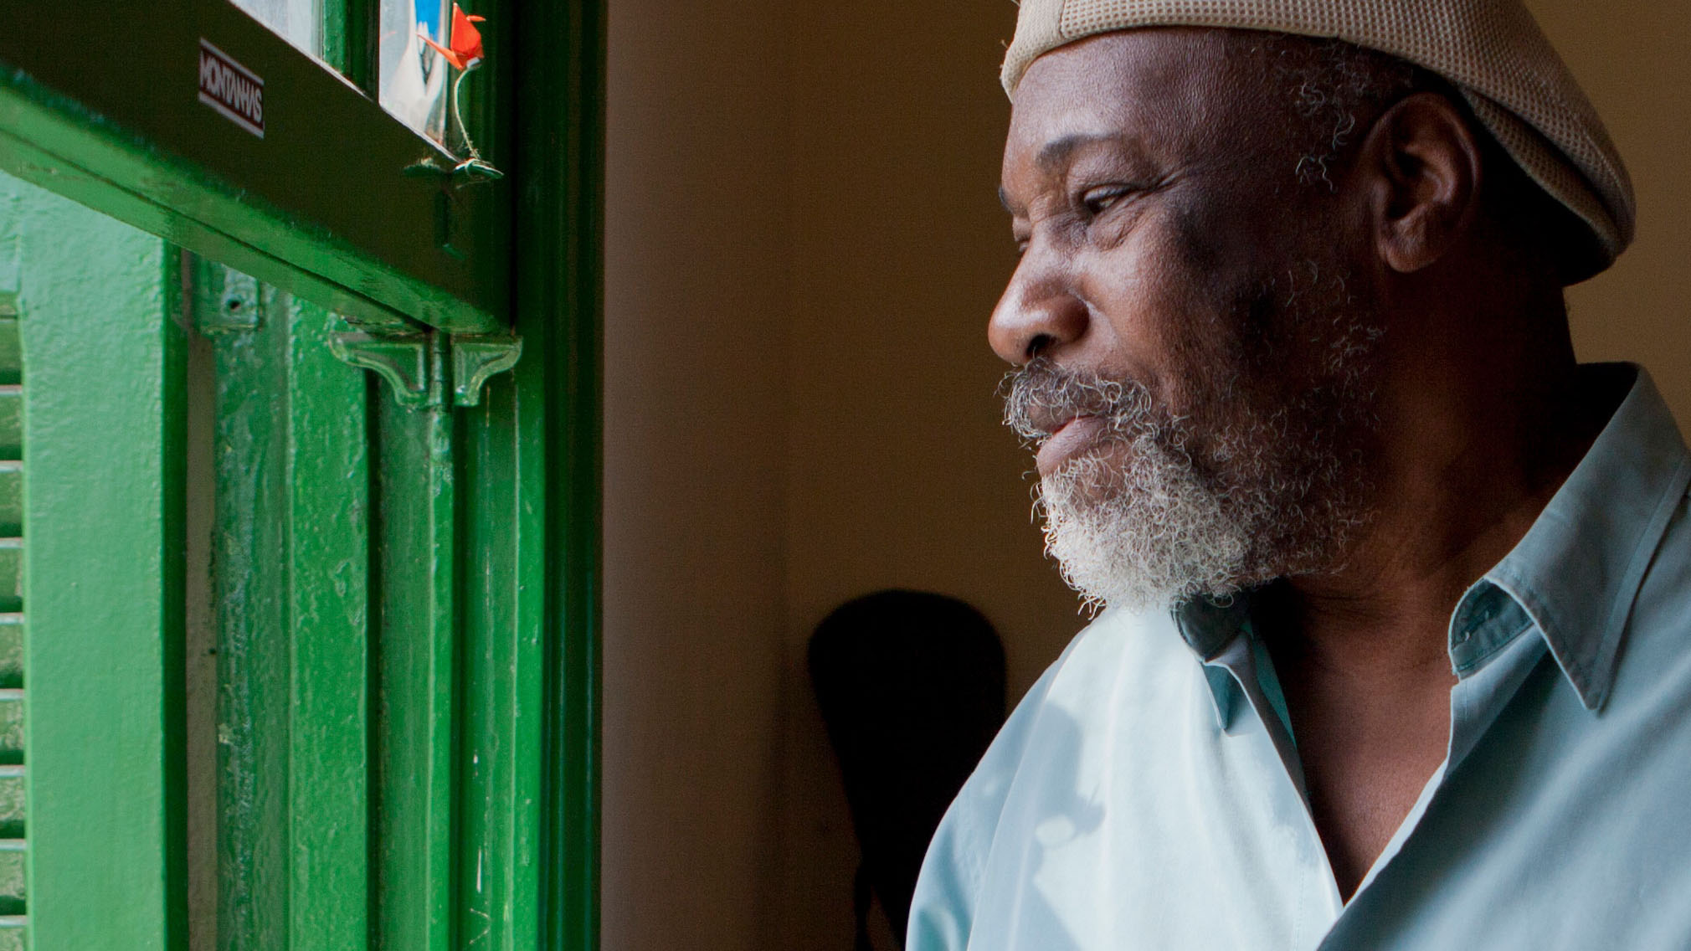
Our purpose
Our heritage enables us to defeat diabetes and other serious chronic diseases
Otávio Domingos da Costa
Otávio has type 2 diabetes and obesity
Brazil

Slide 17

17
Driven
by our purpose
The Novo Nordisk Way describes who we are, where we want to go and the values that characterise our company.

Slide 18
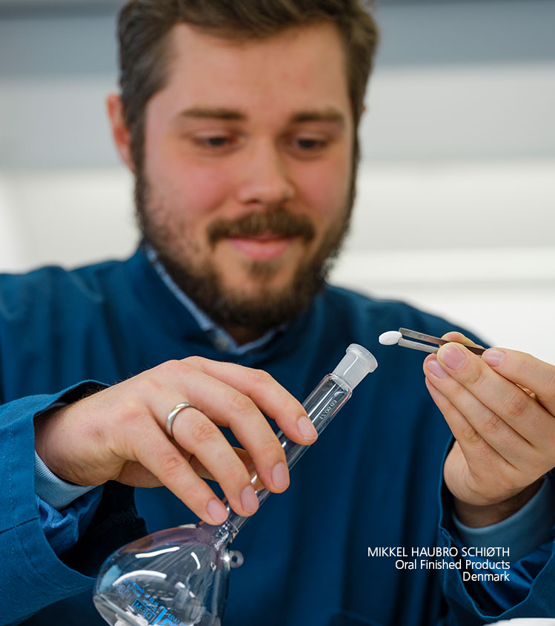
The Essentials
Novo Nordisk®
We create value by having a patient-centred business approach.
We set ambitious goals and strive for excellence.
We are accountable for our financial, environmental and social performance.
We provide innovation to the benefit of our stakeholders.
We build and maintain good relations with our
key stakeholders.
We treat everyone with respect.
We focus on personal performance and development.
We have a healthy and engaging working environment.
We strive for agility and simplicity in everything we do.
We never compromise on quality
and business ethics.

Slide 19
Sustainable
business
By being a sustainable business we add value to society and to our future business.
Notes:
Being socially responsible is about considering the impact we have on people’s lives.
Being financially responsible is about considering the impact we make with the money we earn and how we spend it.
Being environmentally responsible is about considering our impact on the environment in our decisions and all that we do.
Impacts can be positive or negative
We take our point of departure in the patients we serve: Our obligation is to do everything we can for them so that they can live healthy lives. We acknowledge that our activities may have negative impacts to people, communities or the environment. We strive to minimise the negative impacts and maximise the positive impacts, and we always seek to balance the three bottom lines.

Slide 20










We are acting with financial, social and environmental responsibility by considering…
the impact we have with the money
we earn and how we spend it
the impact we have
on people’s lives
the impact we have on the environment
patients
their caretakers
and key stakeholders
Optimise use of
resources
revenue/profit
Minimise
waste
costs
Employees
and their families
sales/volume
Reduce
CO₂ emissions
communities
where we do business
Increase
energy efficiency
market share/size
Notes:
Being financially responsible is about considering the impact we make with the money we earn and how we spend it
Being socially responsible is about considering the impact we have on people’s lives
Being environmentally responsible is about considering our impact on the environment

Slide 21
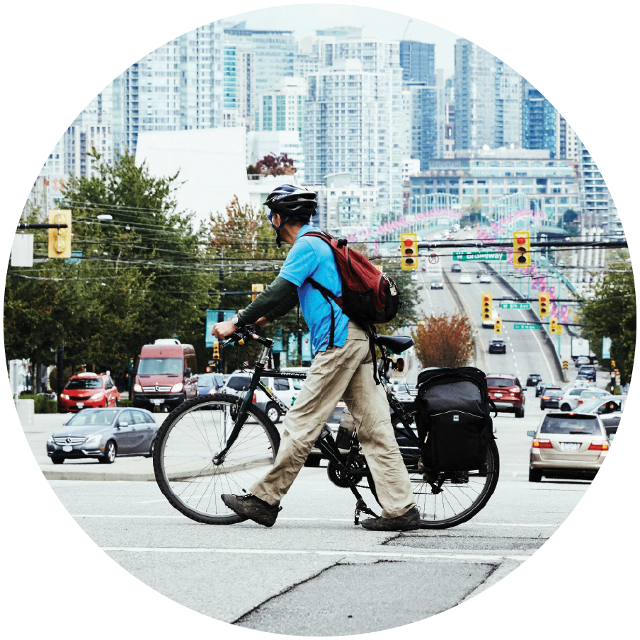
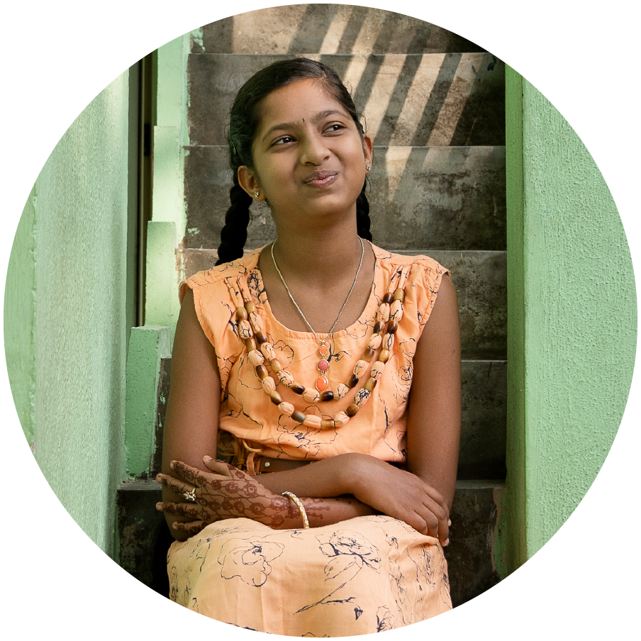
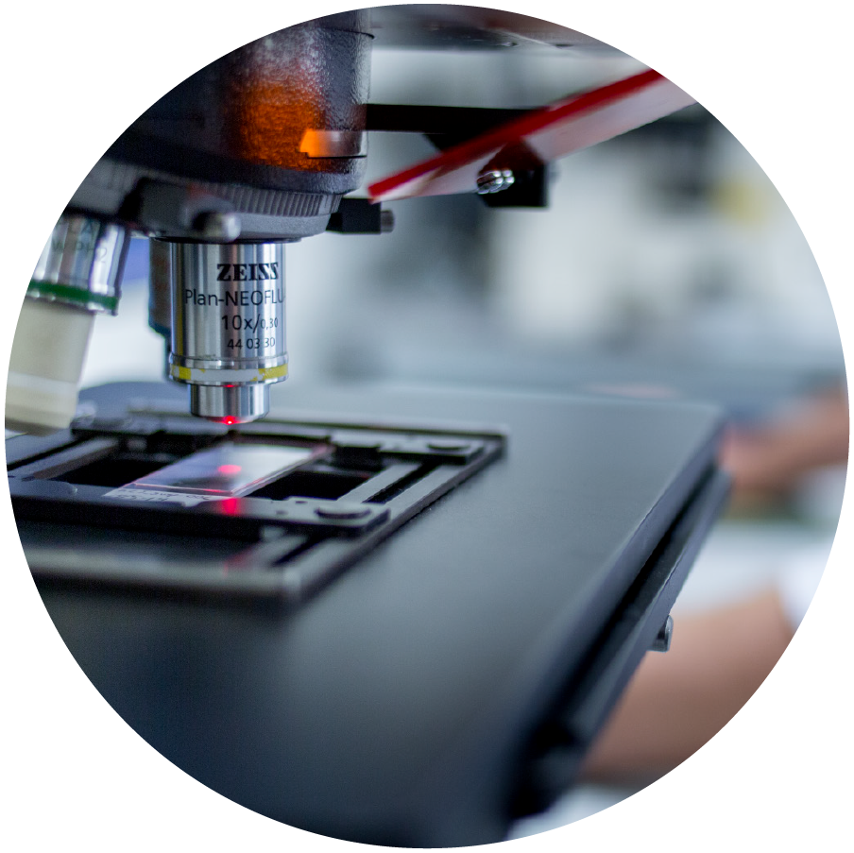

Defeat Diabetes – our social responsibility strategy
1 | Reduce overweight and obesity in children
2 | Strengthen prevention by focusing on health inequality in cities
3 | Bend the global obesity curve
4 | Offer affordable insulin to vulnerable patients in every country
5 | Expand patient access through supply chain improvements and heat stable insulins
6 | Strengthen capacity to treat diabetes
7 | Keep people at high risk from developing diabetes
8 | Explore transformative treatments for people living with diabetes
9 | Strive for curative therapies starting with type 1 diabetes
Notes:
At Novo Nordisk, we are committed to driving change to defeat diabetes and other serious chronic diseases. To fulfil this purpose, we work to prevent and ultimately cure disease, expand access to our medicines, and pioneer scientific breakthroughs.
PREVENTION
It takes more than medicine to defeat a serious chronic disease.
That is why we engage with partners globally to address the root causes of disease and develop interventions to prevent the rise of type 2 diabetes and obesity.
Novo Nordisk will be focusing our efforts across three areas:
Reducing overweight and obesity in children
Strenghtening prevention by focusing on health inequality in cities
Bending the global obesity curve
ACCESS & AFFORDABILITY:
Millions of people rely on us for their life-saving medicines. Yet, only a fraction of patients are being treated because treatment is either not affordable or not available.
We commit to providing access to affordable medicines for vulnerable patients in every country, and we support capacity building within healthcare systems for the future.
Novo Nordisk will be focusing our efforts across three areas:
Offering affordable insulin in every country
Expanding patients access to insulin
Strengthening capacity to treat diabetes
INNOVATION
We collaborate with patients and partners to transform bold ideas into life-saving and preventive medicines.
We make long-term investments in novel treatments and technologies, including curative stem cell-based therapies, and we continually advance the development of medical devices and digital health solutions.
Novo Nordisk will be focusing our efforts across three areas:
Keeping people at high risk from developing diabetes
Exploring transformative treatments for people living with diabetes
Striving for curative therapies for diabetes

Slide 22
Novo Nordisk Graduate Programme
VILJA STEHLE PHILIP VAN BERKOM PAULINA FORSBERG
Procurement Graduates Denmark
Notes:
Text slide
Image left square
Life-changing careers
P&O
People and organization

Slide 23
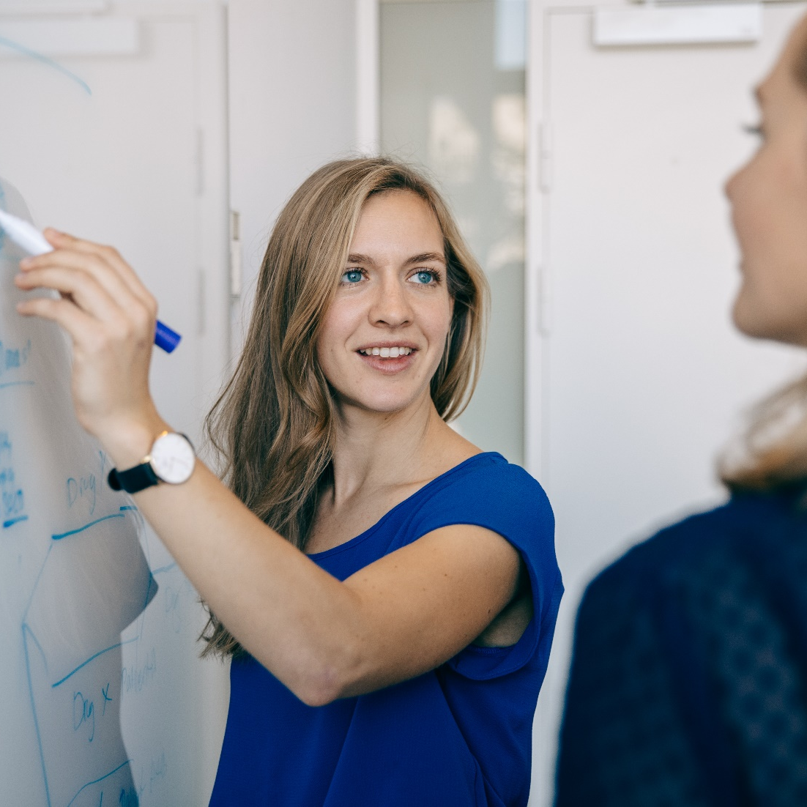
Key building blocks of the graduate programme
MIA ØHLENSCHLÆGER
Trial Management Graduate
Denmark
Duration of two years
Challenging tasks with high responsibility from day one!
Cross–functional projects and broad network
We trust that our graduates will develop into tomorrow’s key people!
3 – 4 rotations in different geographical locations and different parts of the organisation
International orientation and a diverse graduate family!
Focus on personal and professional development
Notes:
Video from GRC 2019

Slide 24




Graduate programme set-up
All Graduates at the International Operations Business Graduate Programme will go through the following three streams: Project Management, Marketing & Sales and Finance-related projects
1st rotation
Intro to corporate life
Hands-on learning
Local experience to understand regional business priorities and to know affiliate challenges
3rd rotation
Experienced Professional
Contribution
Regional experience
3rd rotation individually designed according to local vs. global business need at Graduate fit
2nd rotation
International Experience
Insight & Responsibility
Headquarter experience
Post-graduate opportunities
Post graduates
After the Graduate Programme our Graduates are hired locally in positions like:
Project coordinator/manager
Internal consultants
Specialists
Analyst
Etc.
Notes:
Process
Looped process
4 steps
P&O
Life-changing careers
People and organization

Slide 25




Two years with personal and professional development
Training
Network
Mentoring
Global career
Programme Manager
Host Manager
Mentor
Buddy
Personal development
Presentation skills Project management
Internal
External
International
International rotations
Cultural training
Notes:
Looped process 4 steps
Circle diagram
Corporate consulting
Process
Looped process
4 steps
P&O
Life-changing careers
People and organization

Slide 26

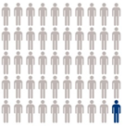


Graduate campaign 2020 | Facts and figures
Candidate numbers
Top 10 nationalities
Face-2-Face
Applications
2
2624
Open Tracks
12
…of the applicants have engaged with Novo Nordisk before applying
BRITISH
48%
DANISH
131
GERMAN
47 hires
SPANISH
First
interviews
278
Graduate Recruitment Centre
ITALIAN
INDIAN
CHINESE
…and that number is even higher for the GRC invited candidates
70%
ALGERIAN
KENYAN
INDONESIAN
Gender split
International
experience
On average, the candidates have had
2 years and 2 months
of international experience
- working or studying abroad
51%
98 different nationalities applied for the graduate programmes in 2020
49%
89% of the applicants were Non-Danes

Slide 27
Graduate programme job opportunities 2021
Research &
Development
Business, Marketing
HR & Market Access
Finance &
Procurement
Medical, Regulatory & Safety
Global Business
Global Marketing
Global Market Access
International Operations Business in
Poland, Gulf Cluster, Thailand, Pakistan, Korea, India, Brazil and Columbia
International Operations People & Organisation (HR) in Turkey and Italy
Global Procurement
Global Finance
European Finance
International Operations Finance in
Denmark, Philippines, Indonesia, Australia, Brazil, Colombia, Mexico, Poland, Turkey and Algeria

Slide 28

Some questions to think about…
YANNICK VAN BALLAER and MARIANA PRADO
Global Business Graduates Denmark
Am I interested in health topics and willing to learn about pharmaceutical products?
Am I ready for changes and being outside my comfort zone?
Am I willing to relocate and travel?
Am I willing to challenge and be challenged?

Slide 29
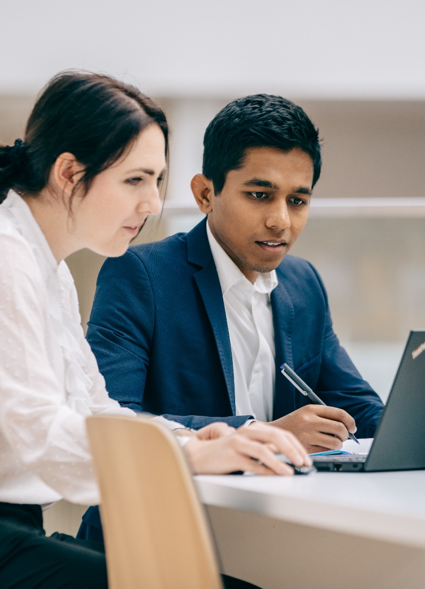
What does the application process look like?
NADIA VINCENTS NIELSEN and ARUN RAMANATHAN
Global Finance Graduates
Denmark

Slide 30




Graduate recruitment process
17 November 2020 – 6 January 2021
February 2021
1 September 2021
Upload application
2nd interview
Graduate Recruitment Centre
1st interview
Start date
January – February 2021
2-3 March 2021
Notes:
Timeline
5 steps
P&O
Life-changing careers

Slide 31

What are we looking for?
PHILIP VAN BERKOM and ALLISON MCPHERSON
Global Procurement and Global Marketing Graduates
Denmark
NADIA VINCENTS NIELSEN and ARUN RAMANATHAN
Global Finance Graduates
Denmark

Slide 32
Graduate Programme Tracks
Research & Development
Finance & Procurement
Business, Marketing, HR & Market Access
Global Development
Data Management Systems & Standards*
Global Development
Epidemiology*
Global Development
Data Science*
Global Development
Trial Management*
Global Development
Trial Data Management*
Global Development
Medical Writing*
Medical, Regulatory, & Safety
International Operations Finance *
International Operations Business
International Operations P&O
Global Business
Global Marketing
Programme
Very Relevant
Global Finance
Global Procurement
Market
Access
Relevant
Supply Chain Management
International Business Admin/Management
Marketing / Communication
Accounting
Finance / Economics
Innovation & Entrepreneurship
IT / Information Management
Engineering
Natural Science / Pharmaceutical
Public Affairs / Law / Political Science
Sociology / Health Economics
Human Resource Management/Psychology
Field of Study
*Global Development hiring again in 2022

Slide 33

The graduate profiles
High drive and eagerness to learn
Be globally mobile
A relevant Master’s degree from 2020 or 2021
International experience from studying or working abroad
Excellent fluency in English
Personal qualifications
Professional qualifications
Above average academic achievements
Relevant experience from work or extracurricular activities
Team-player mindset
Excellent communication skills
International outlook and the ability to adapt quickly to change
Notes:
International experience:
Studying a full semester or working abroad. Back packing around the world does not count as international experience ;o)
Relevant experience from work or extracurricular experience – how important is that?
It’s not the top, top prioritized qualification, but it can show something about what drives you, what hard and soft skills you have learned from eg being part of a sports team
Globally Mobile
Important that you are truly globally mobile, since you can be placed anywhere in the world for 6 – 16 months
Having a high drive for learning and being able to adapt to change is important, as you will have 3-4 different roles during the 2 years

Slide 34
34
Novo Nordisk®
Graduate Programmes – at a glance
Former graduates taking up key positions
CEO
EVP
CVP
77%
88%
GM
VP
Manager/Director
Sr./Project Managers
Still with NN today
(1999-2016)
Retention rate
(2001-03 programmes)
Sr./Specialists

Slide 35



Next Steps
Apply!
Check the Novo Nordisk Careers Page to apply on Nov. 17!
Reach out to us
Feel free to contact us with any other questions you may have, through email or LinkedIn
WEBINARS
10-12 November
2-8 December
▪️12th November https://lnkd.in/epYNtRf
▪️2nd December https://lnkd.in/epGdazd
▪️8th December https://lnkd.in/ega-TBh
Notes:
Process
Looped process 3 steps
P&O
Life-changing careers
People and organization

Slide 36
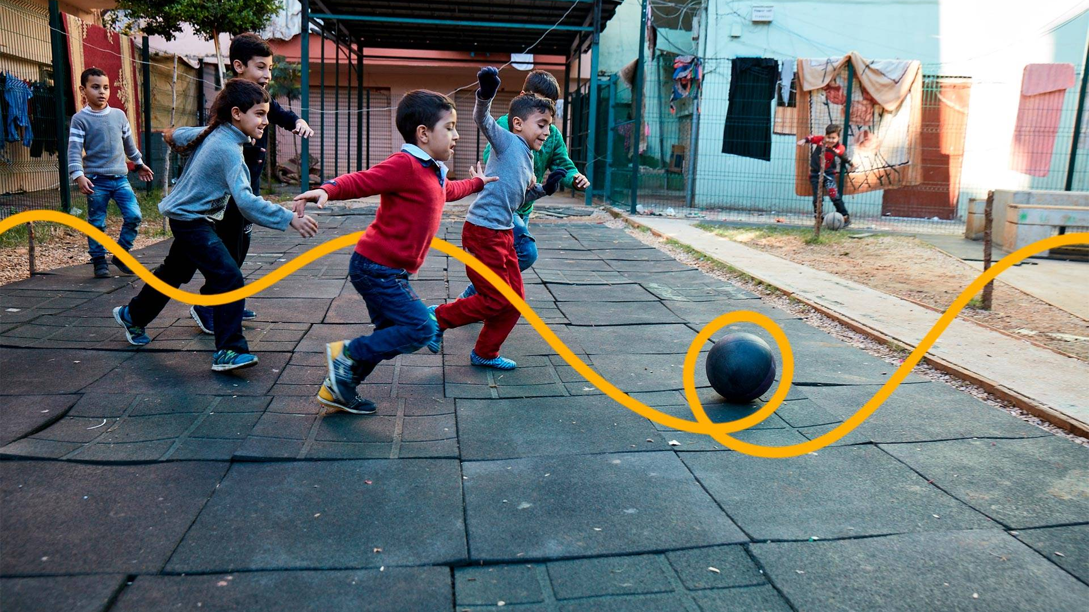
Q&A?
Notes:
Title slide
Front page
First page
Life-changing careers
P&O
People and organization

